Slide 2
Hello! My name is TK and I work at Catterbury Cathedral. We've just had a delivery ready for our Pentecost Service tonight... a BELL-RINGING machine. Due to the current restrictions, we want as few kitties in the cathedral as possible, so our bells are going to be automated!

Slide 3
One problem. I haven't got all of the QR code needed to be able to get the machine playing the right tune... At the moment, it's only playing Christmas songs! O Little Town of Purrrrthlehem is a lovely tune but not very... Pentecost.

Slide 4
Can you help me? I'm trapped in the bell tower but I have my TABi (that's my tablet) and I've given you remote access. Let's see if my friends at cathedrals across the world can help me find the pieces of the QR code!

Slide 5
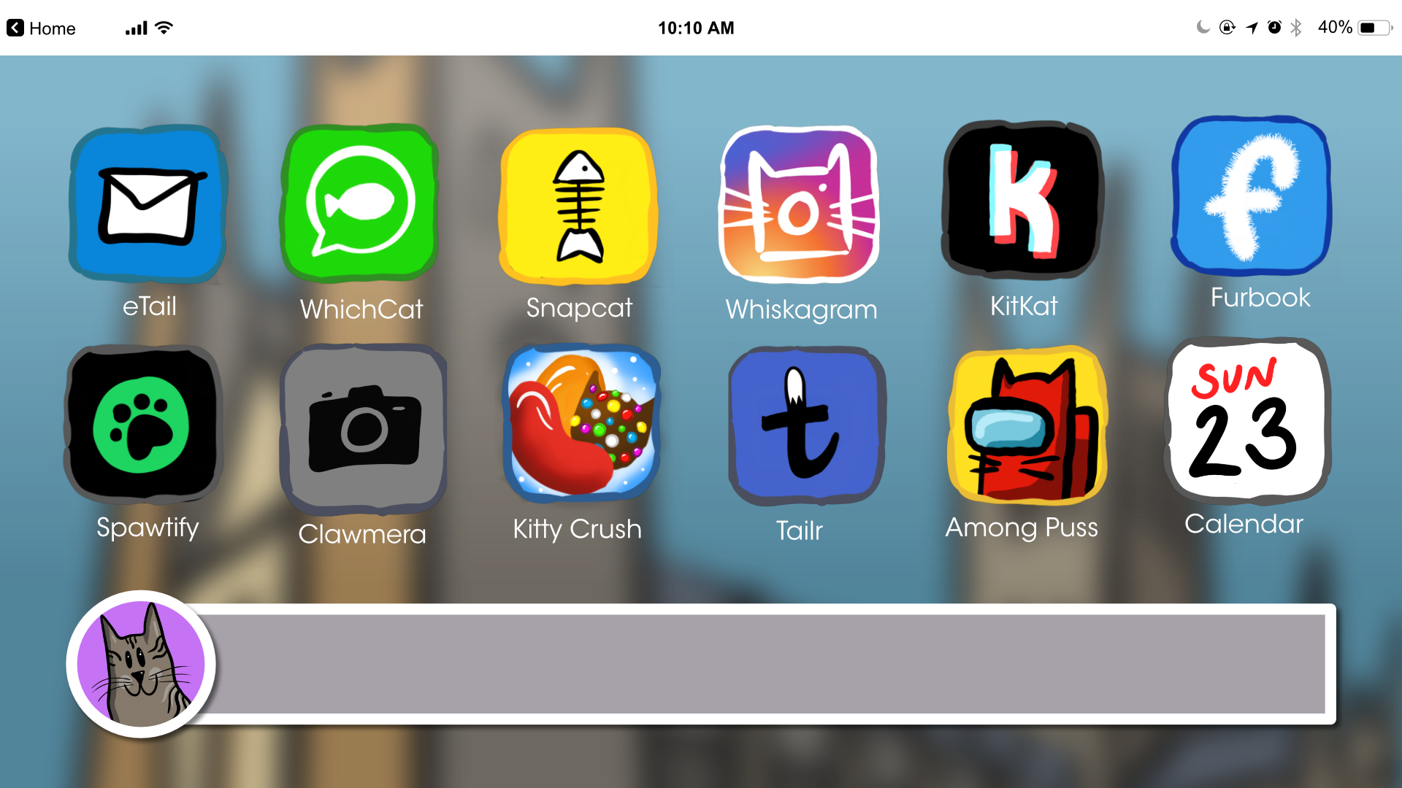
This is my home screen! Why not click an app to see which of my friends can help us out...

Slide 6
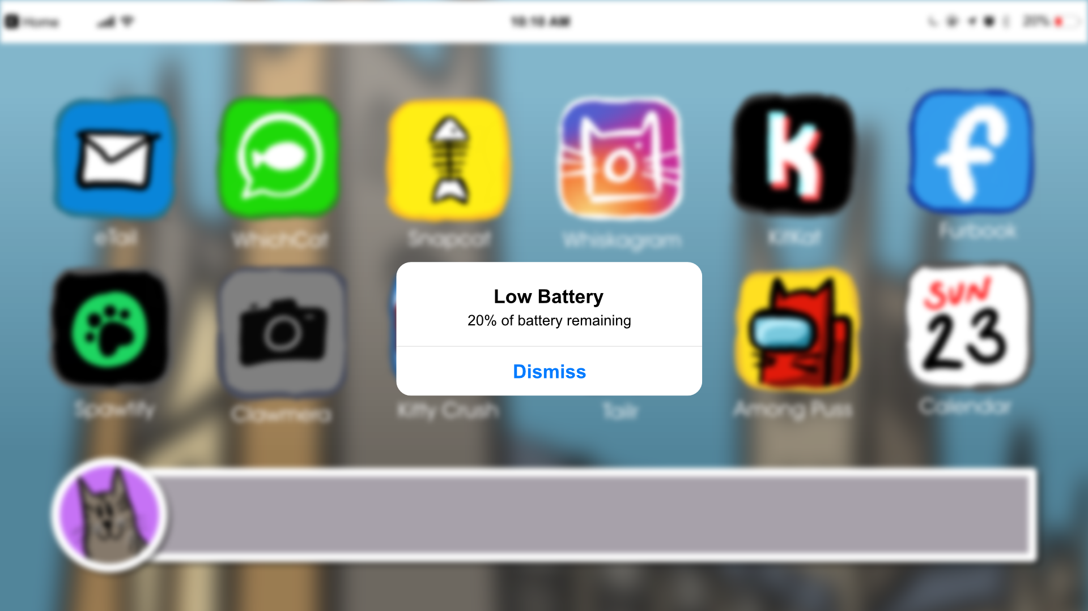
Oh no... low battery... press the back button to charge up!

Slide 7
Back! I said back!

Slide 9
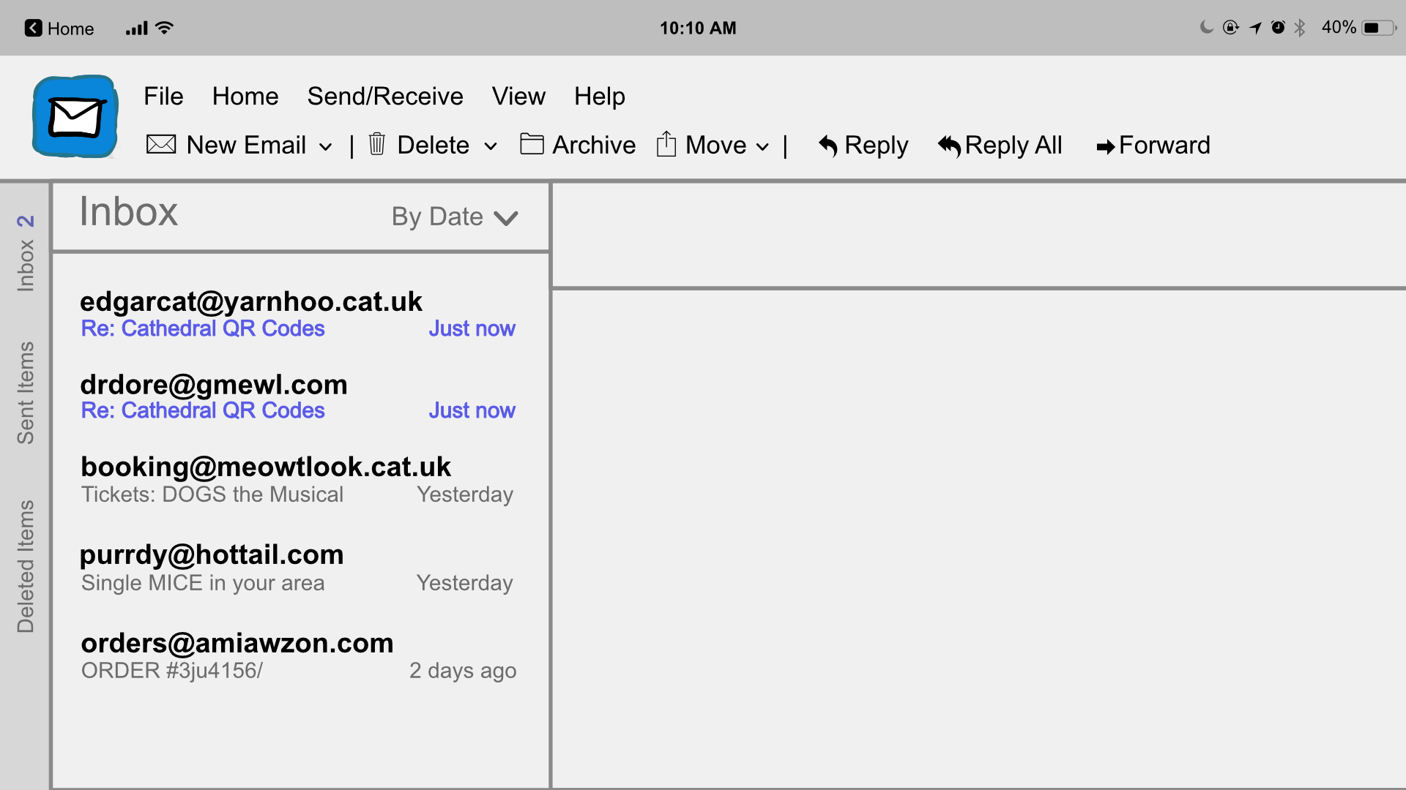

Slide 11
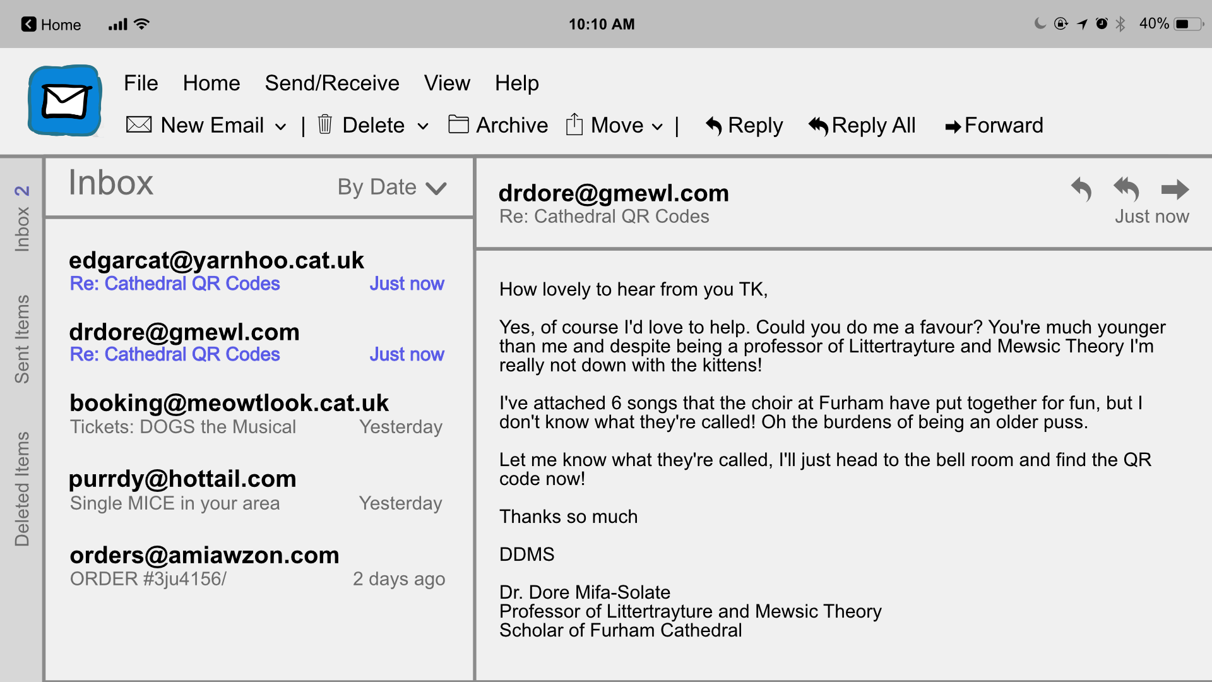

Slide 12
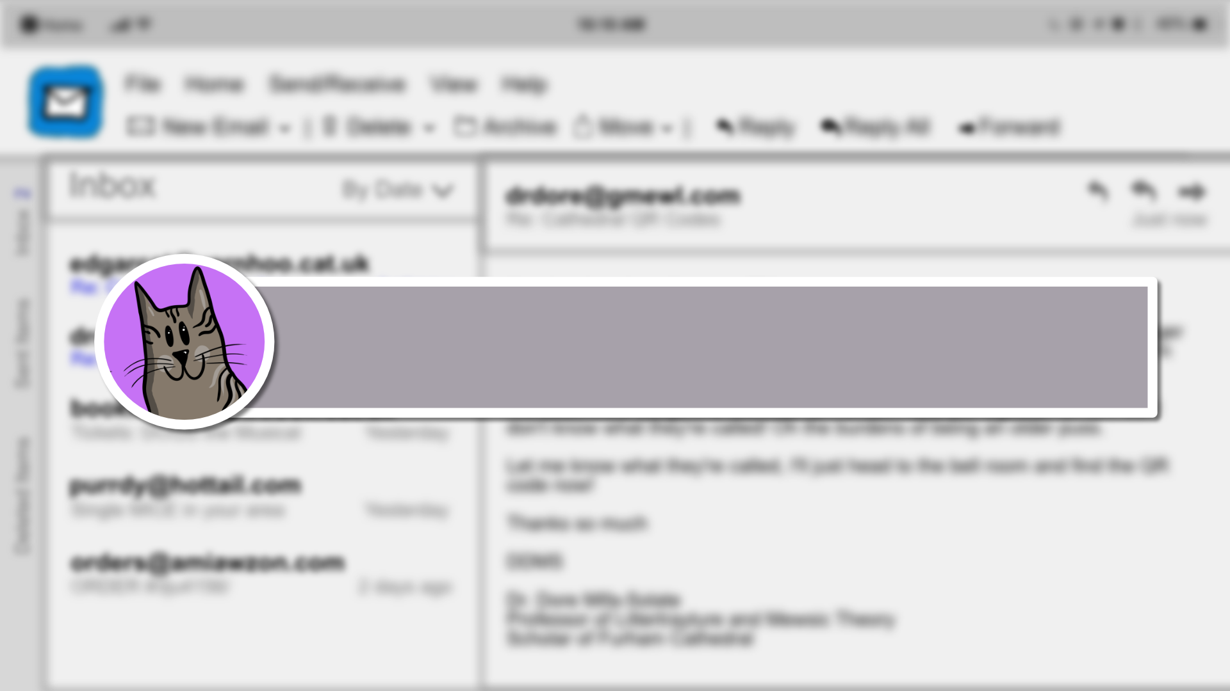
Click the attachments to hear the songs. Can you name them for our friend Dr. Dore?

Slide 13
Think you know all 6? If not, ask for a clue! If you do, click forward and I'll send an email back to Dr. Dore!

Slide 14
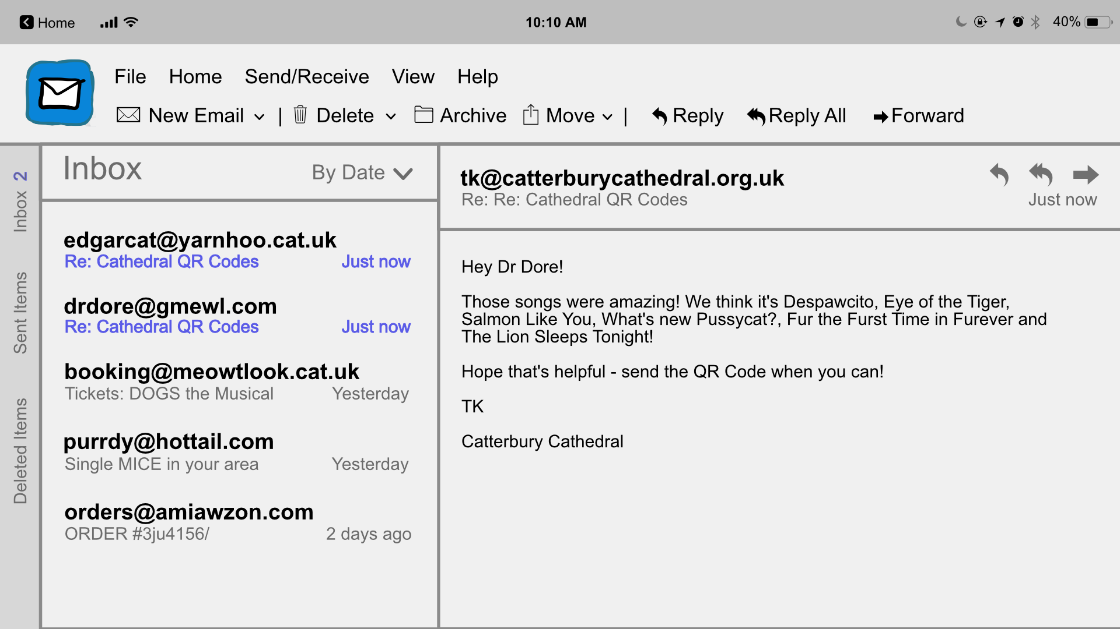

Slide 15
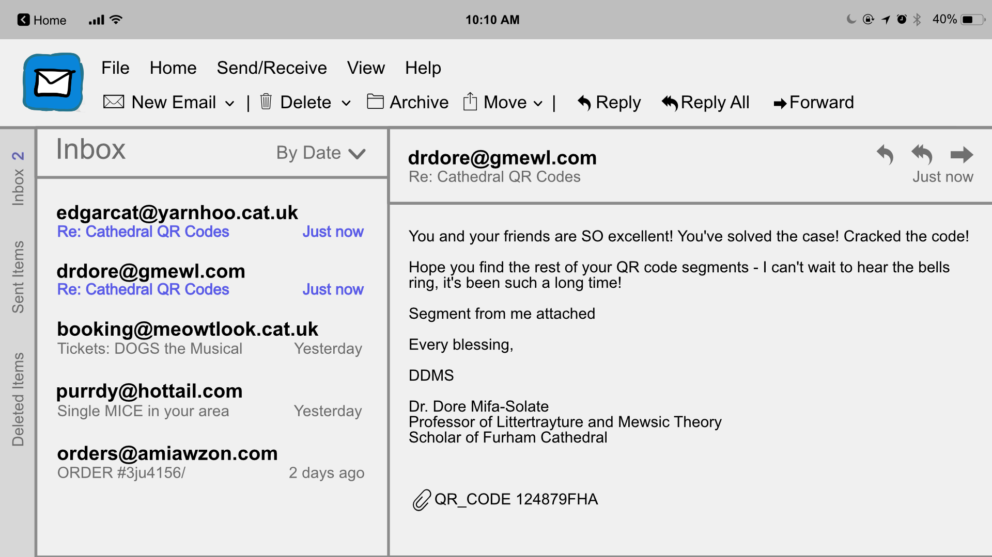
Great work! Click on me to go back to the home page.

Slide 17
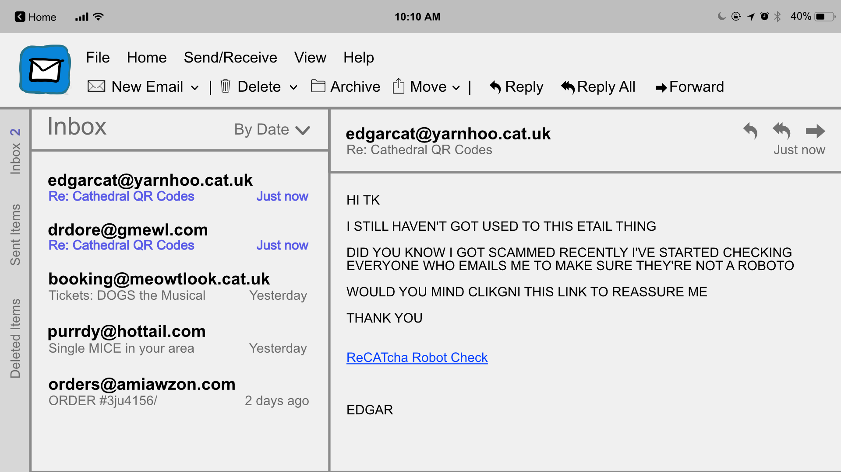

Slide 18
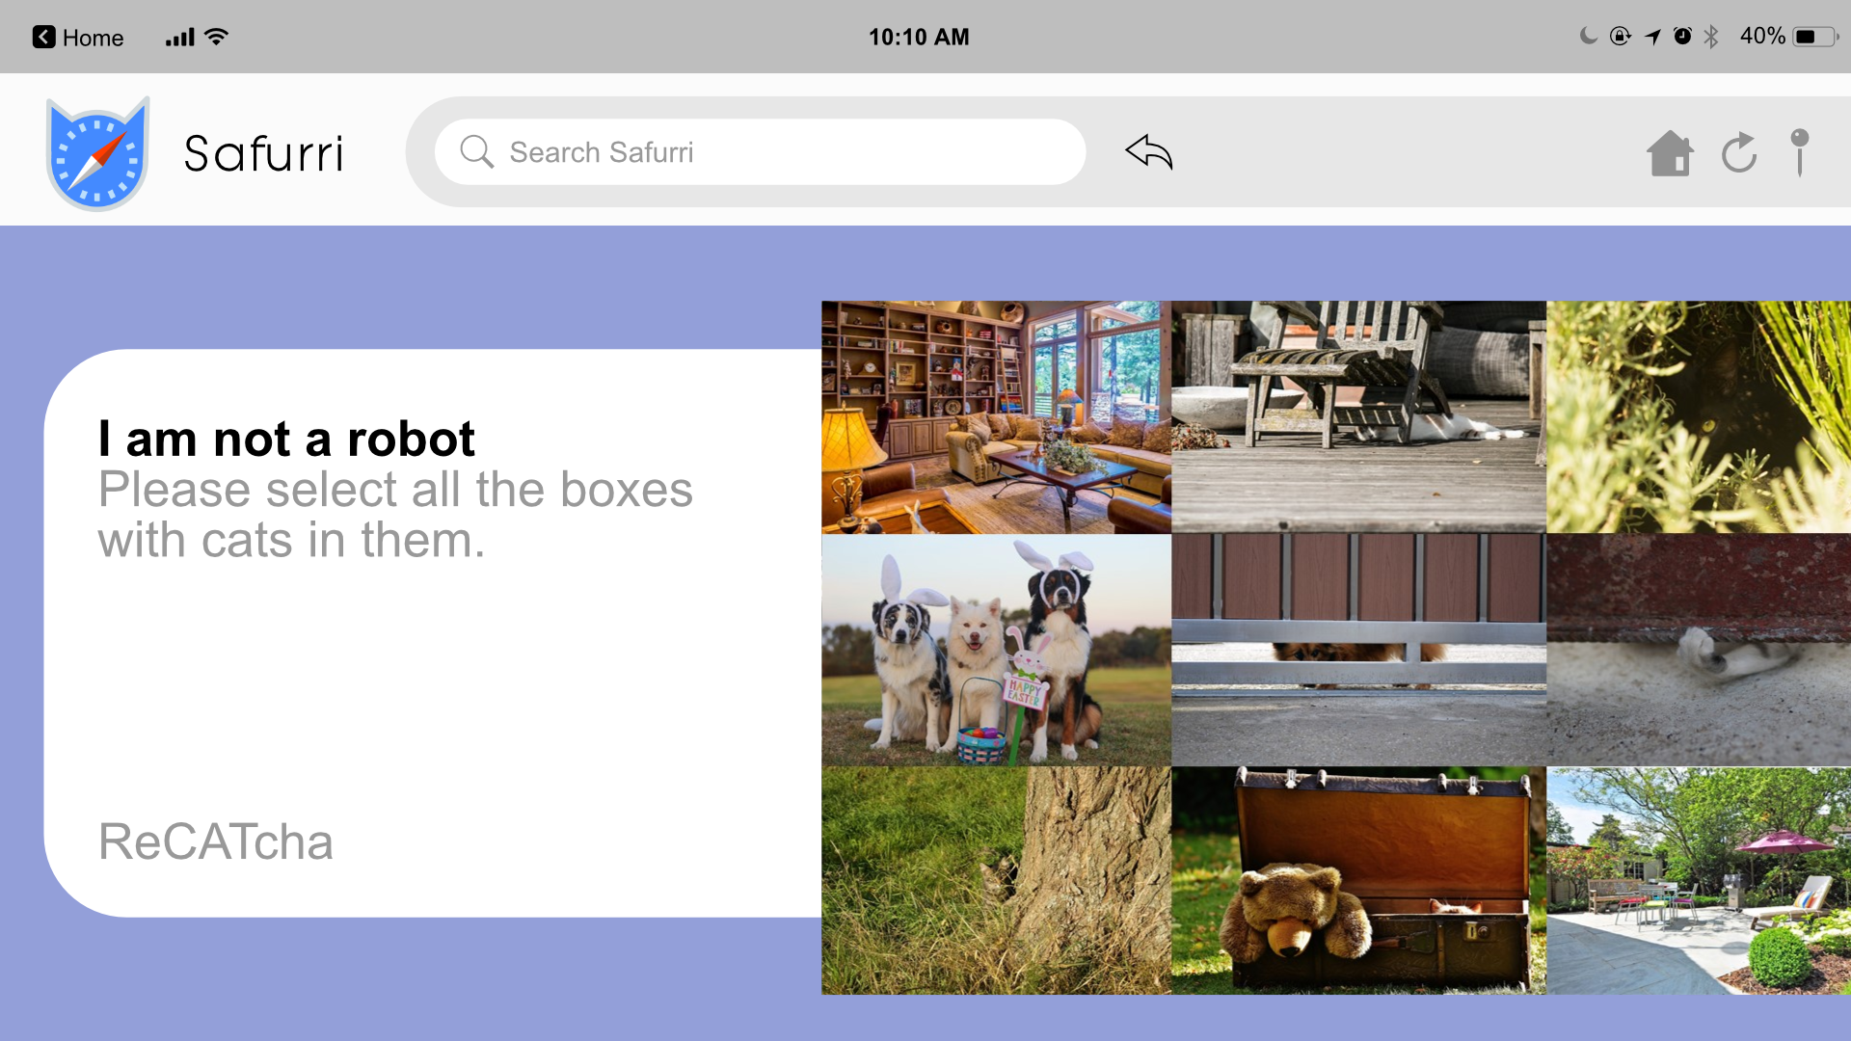
Complete

Slide 19
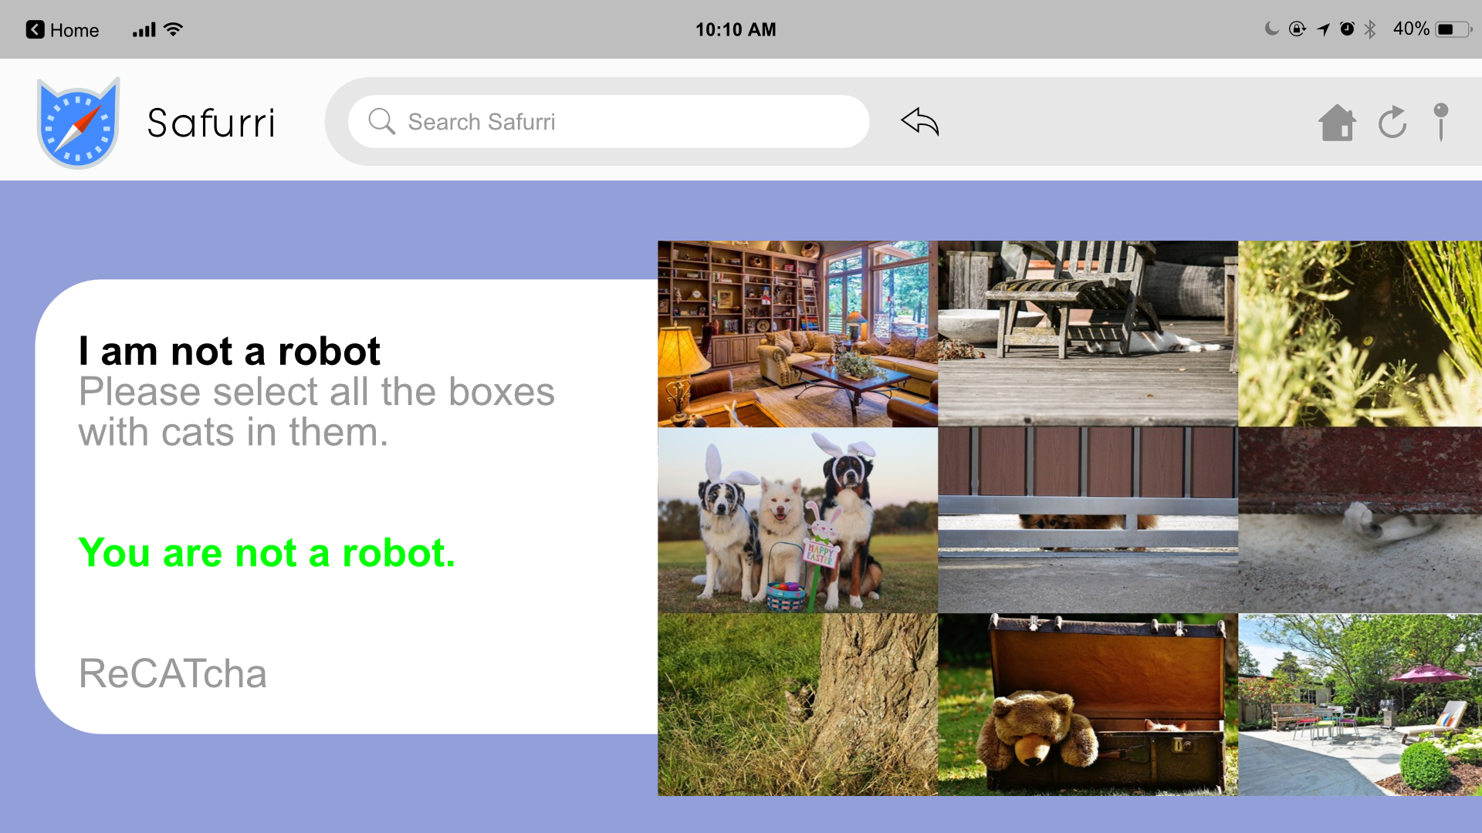
Well done! Click on me and we'll see if Edgar has sent us the QR Code

Slide 20
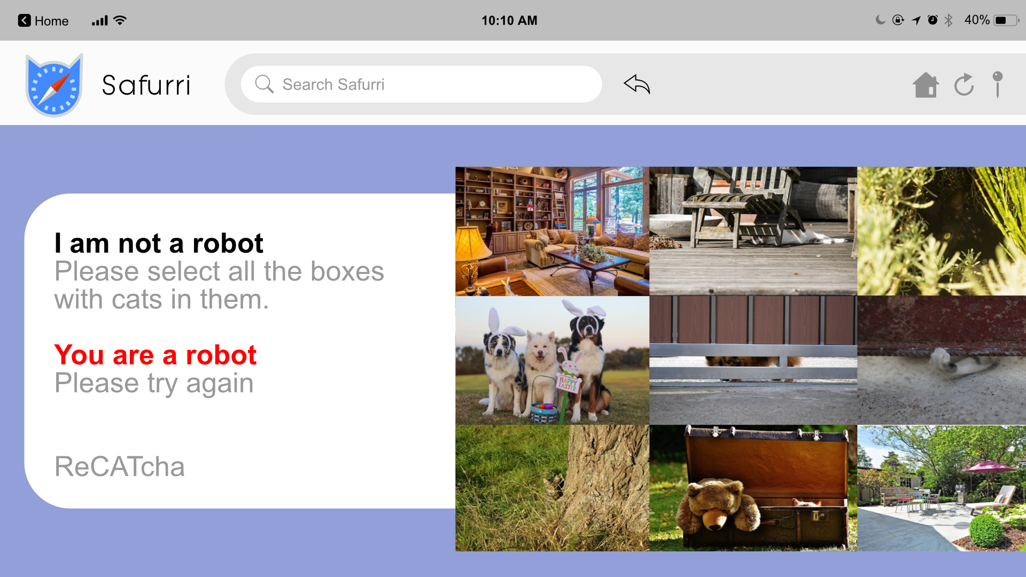
Oh no! Click on me to try again...

Slide 21
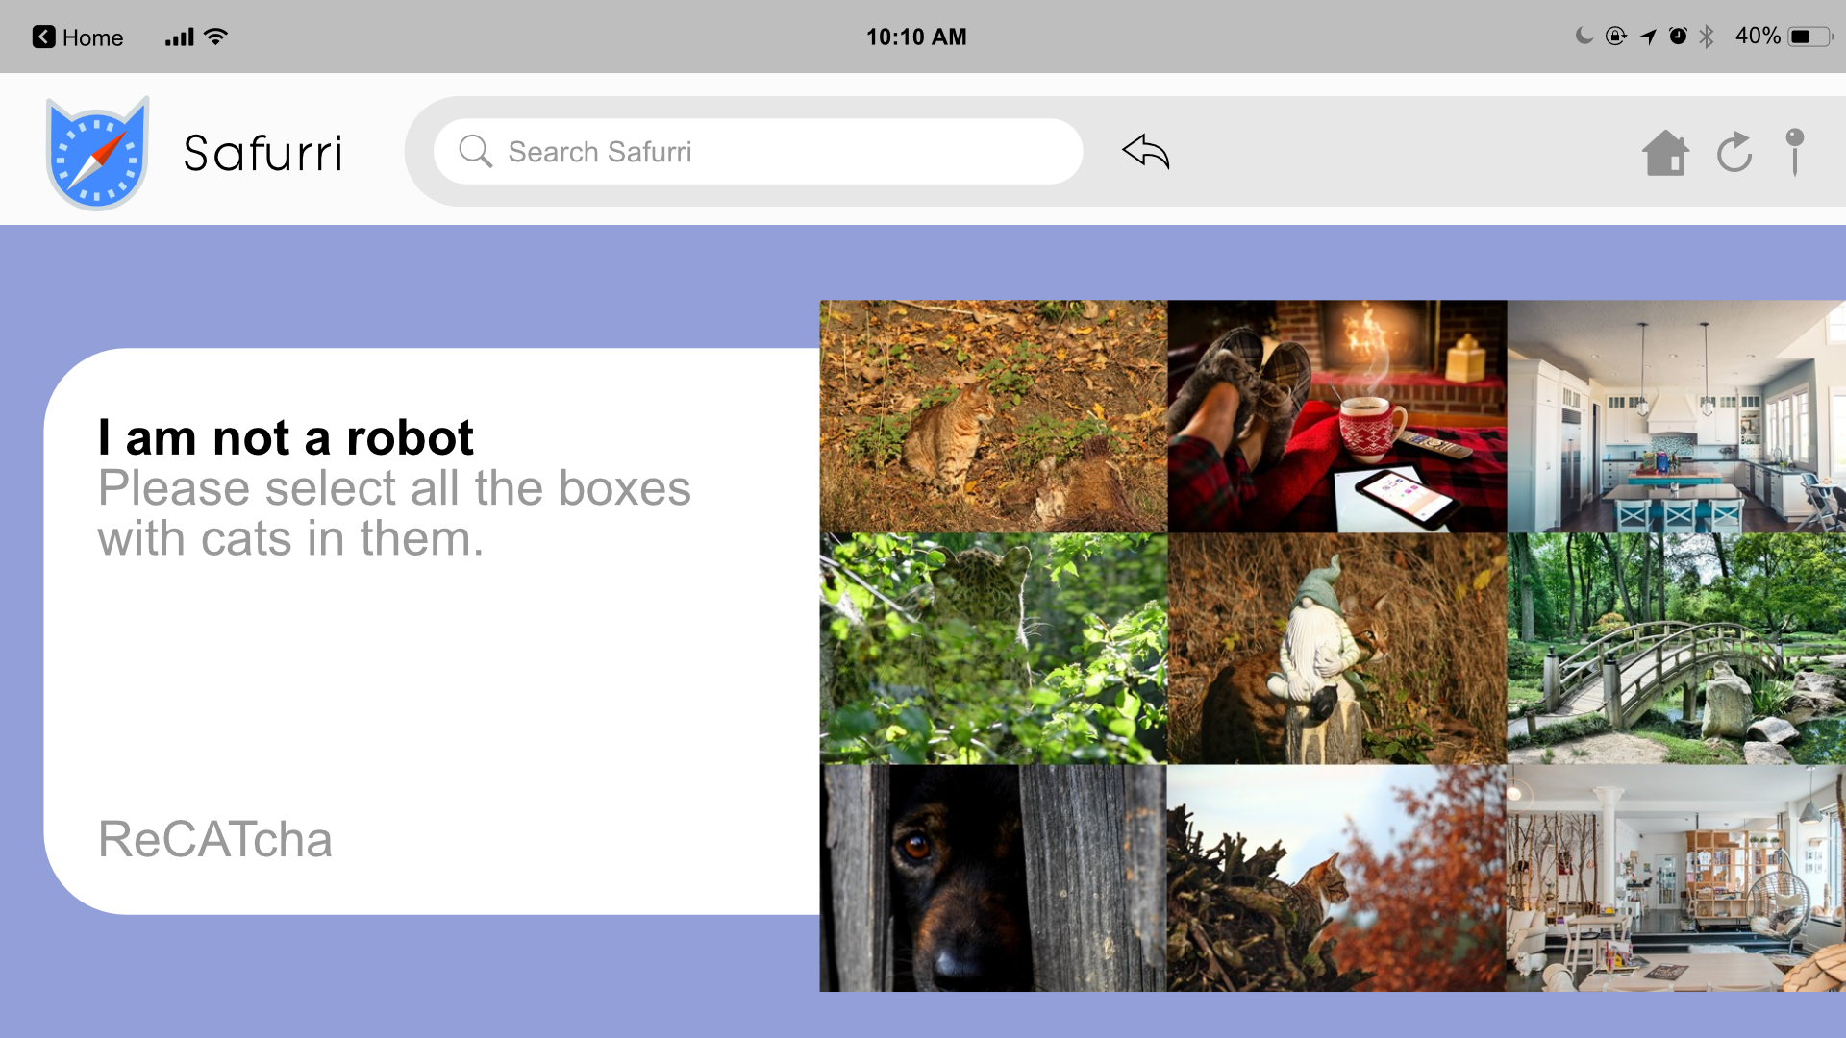
Complete

Slide 22
Well done! Click on me and we'll see if Edgar has sent us the QR Code

Slide 23
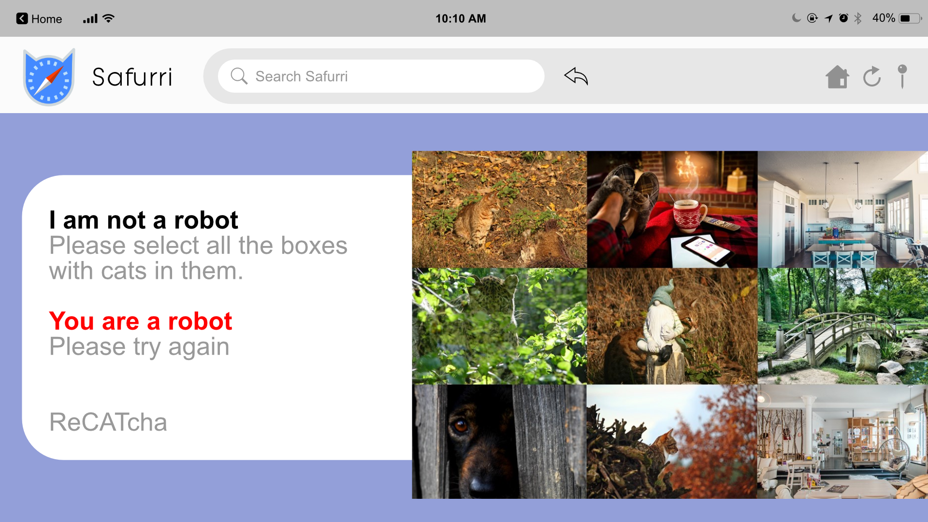
Oh no! Click on me to try again...

Slide 24
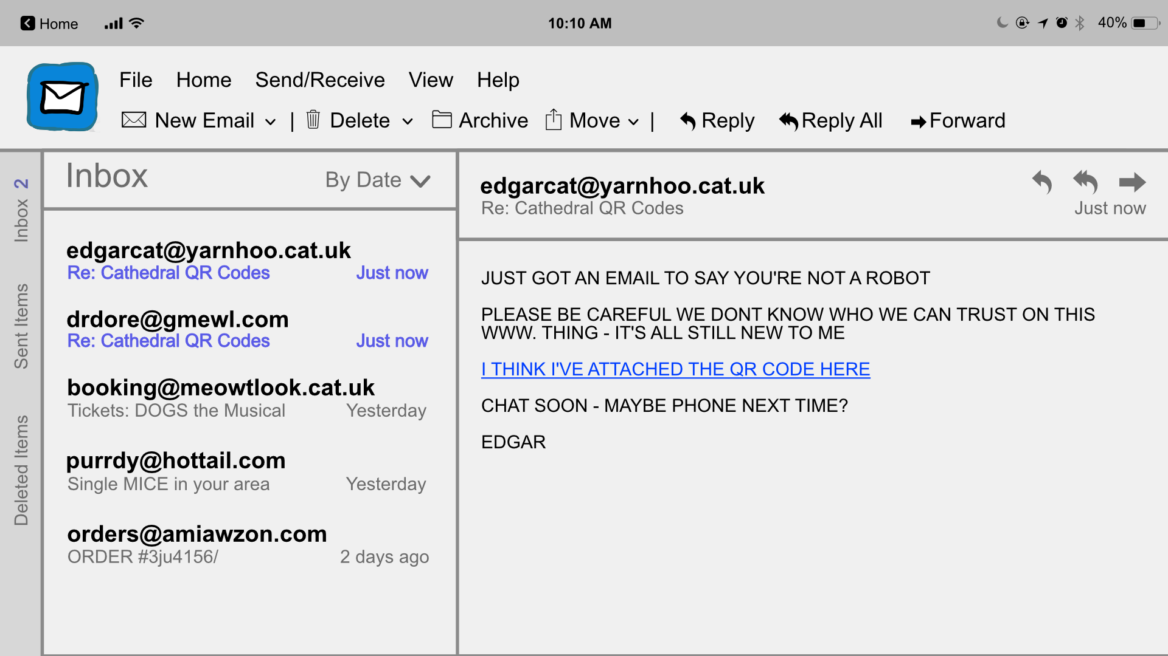
Great work! Click on me to go back to the home page.

Slide 26
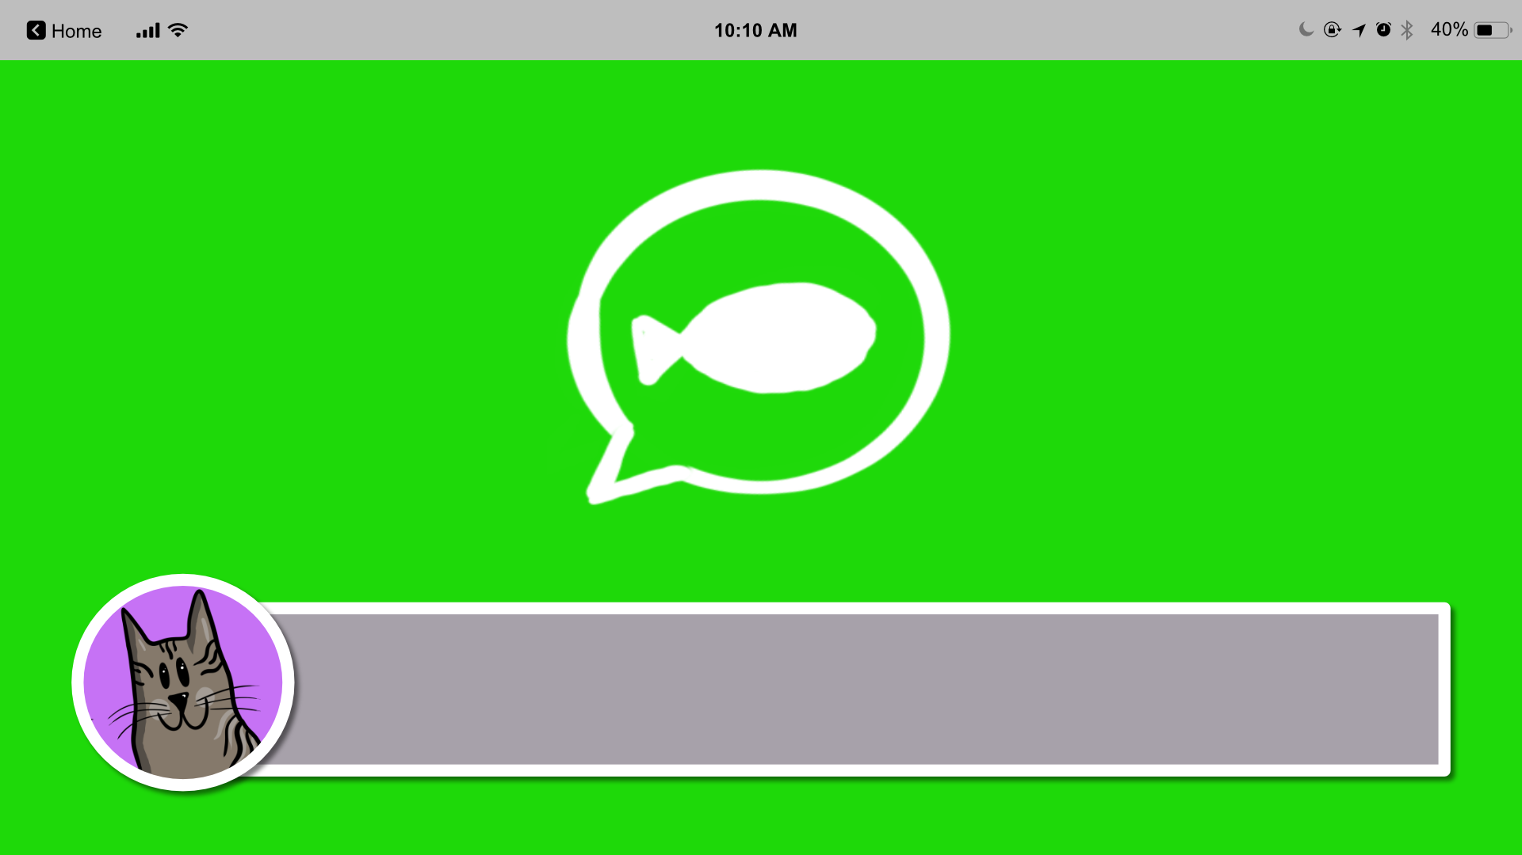
I texted Chad, my friend from Purrth Cathedral in Pawstralia on WhichCat – let's see whether he's replied...

Slide 27
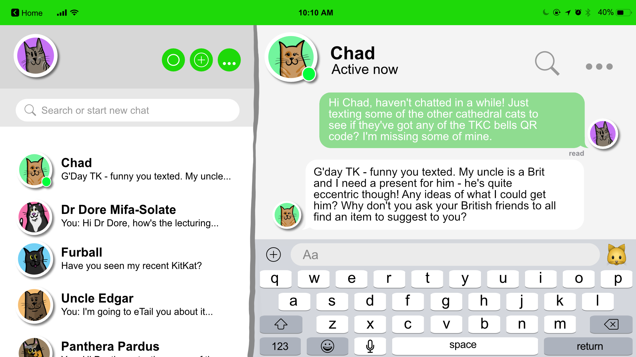

Slide 28
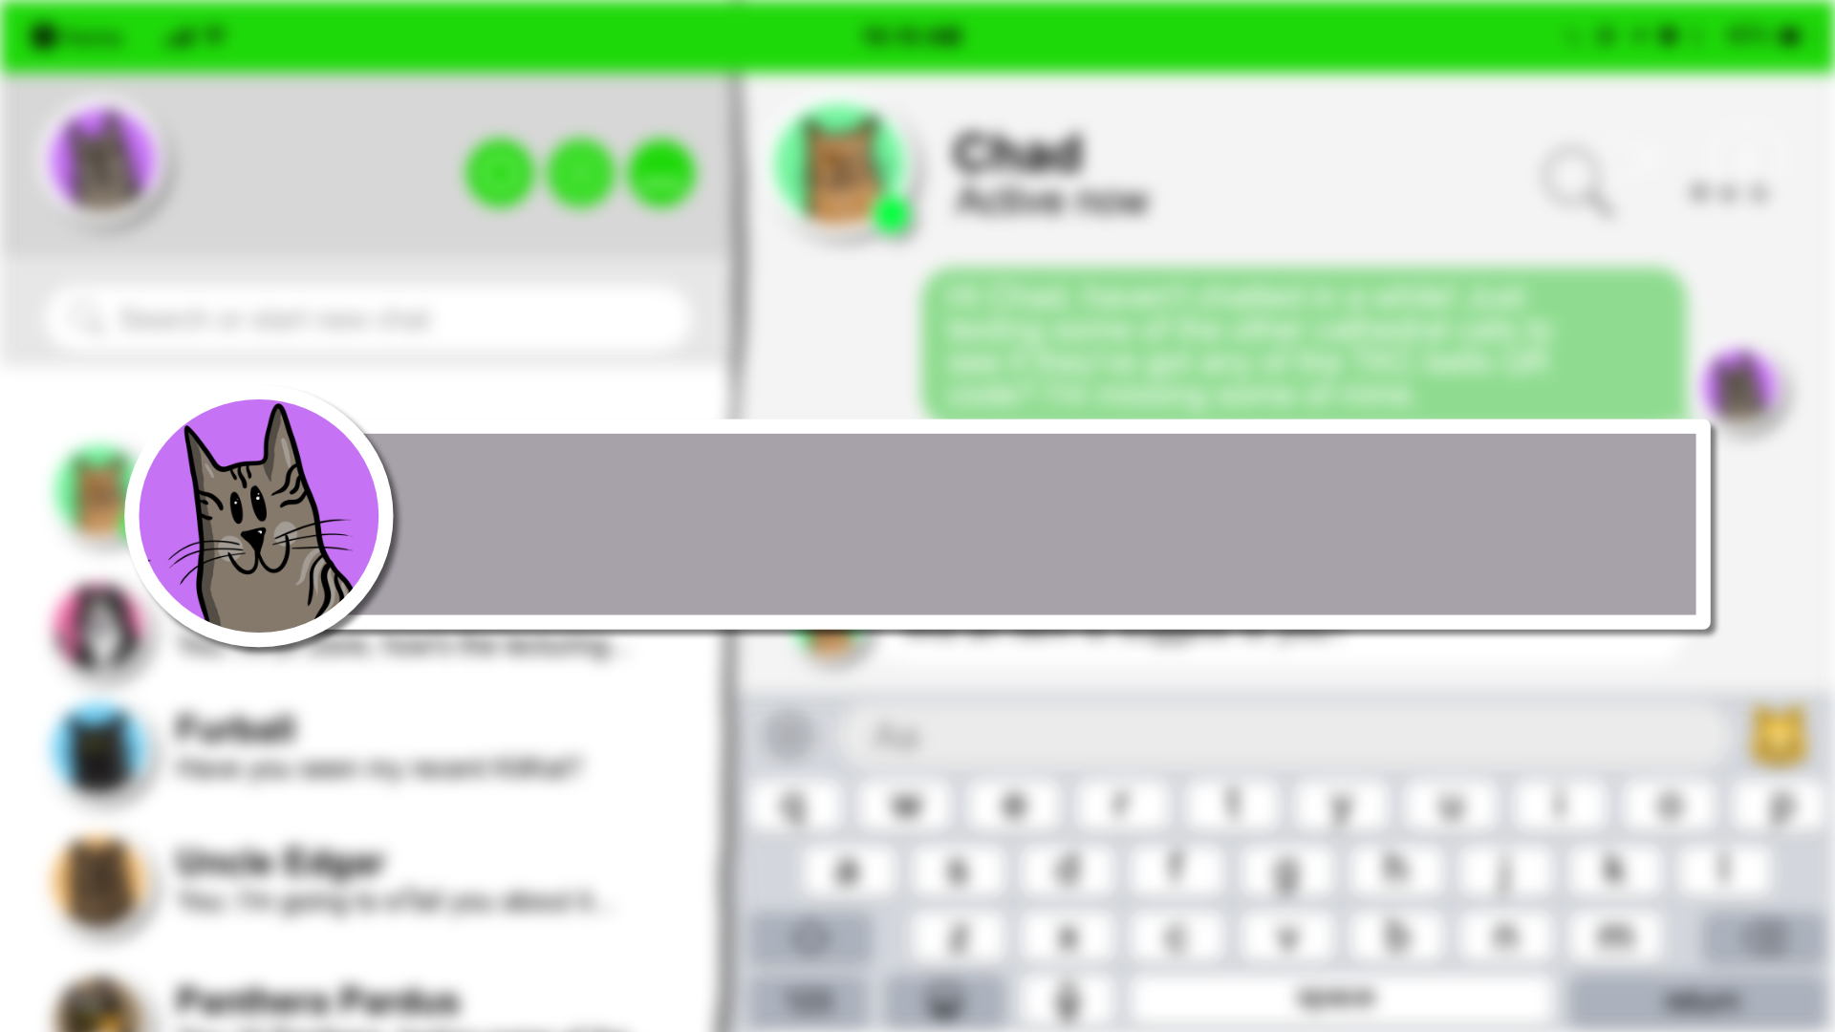
Friends – let's be quick! Find the most eccentric item to give a cat in your house... You have one miaow-nute! Go!

Slide 29
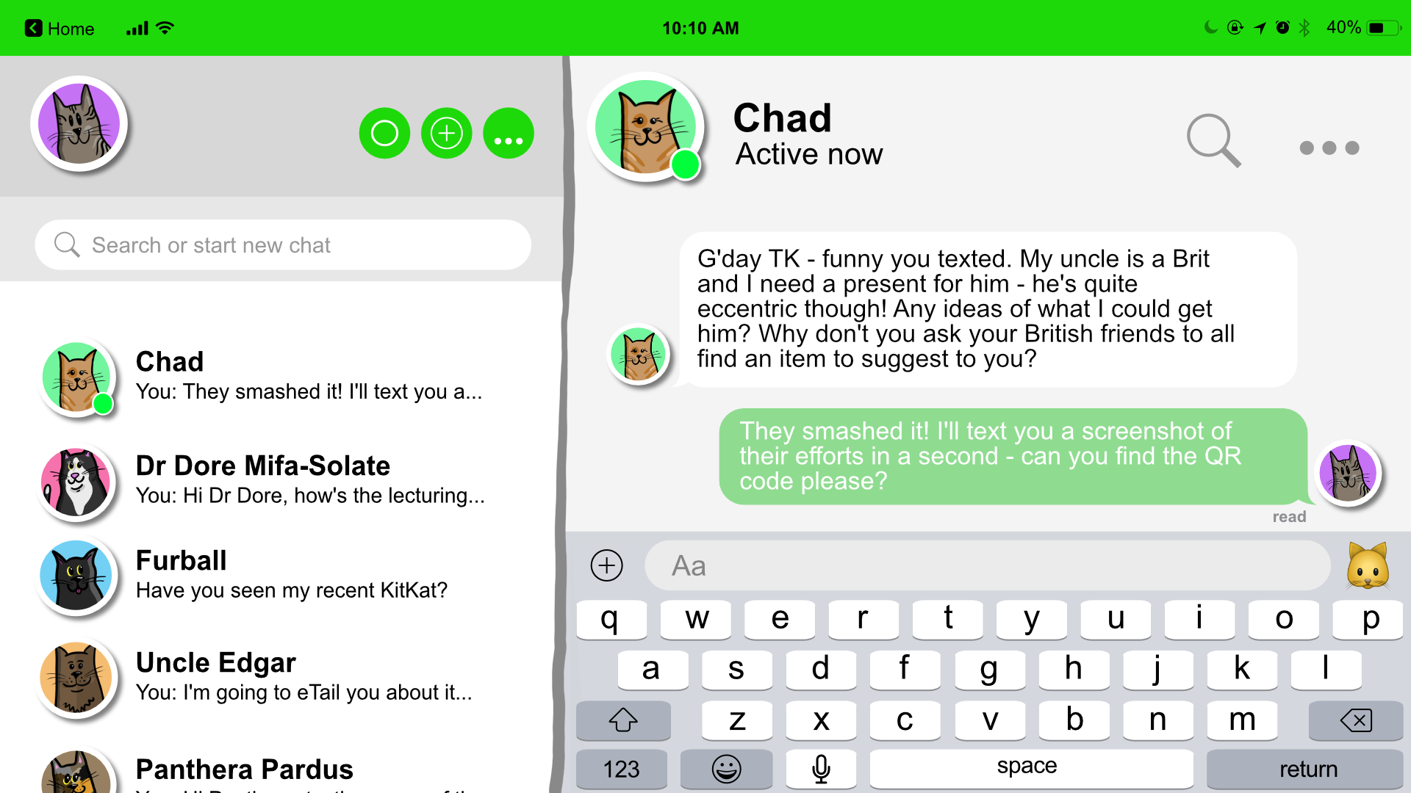

Slide 30
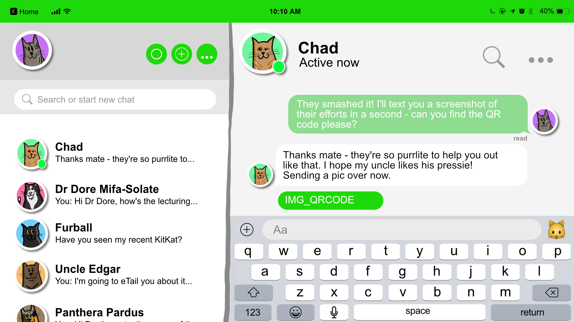
Great work! Click on me to go back to the home page.

Slide 32
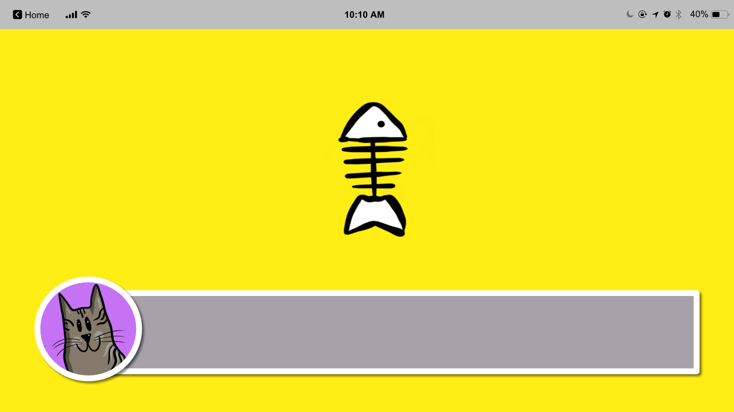
My mate, DJ, is always snapping me. I've asked him if he has one of the QR code pieces we need!

Slide 33
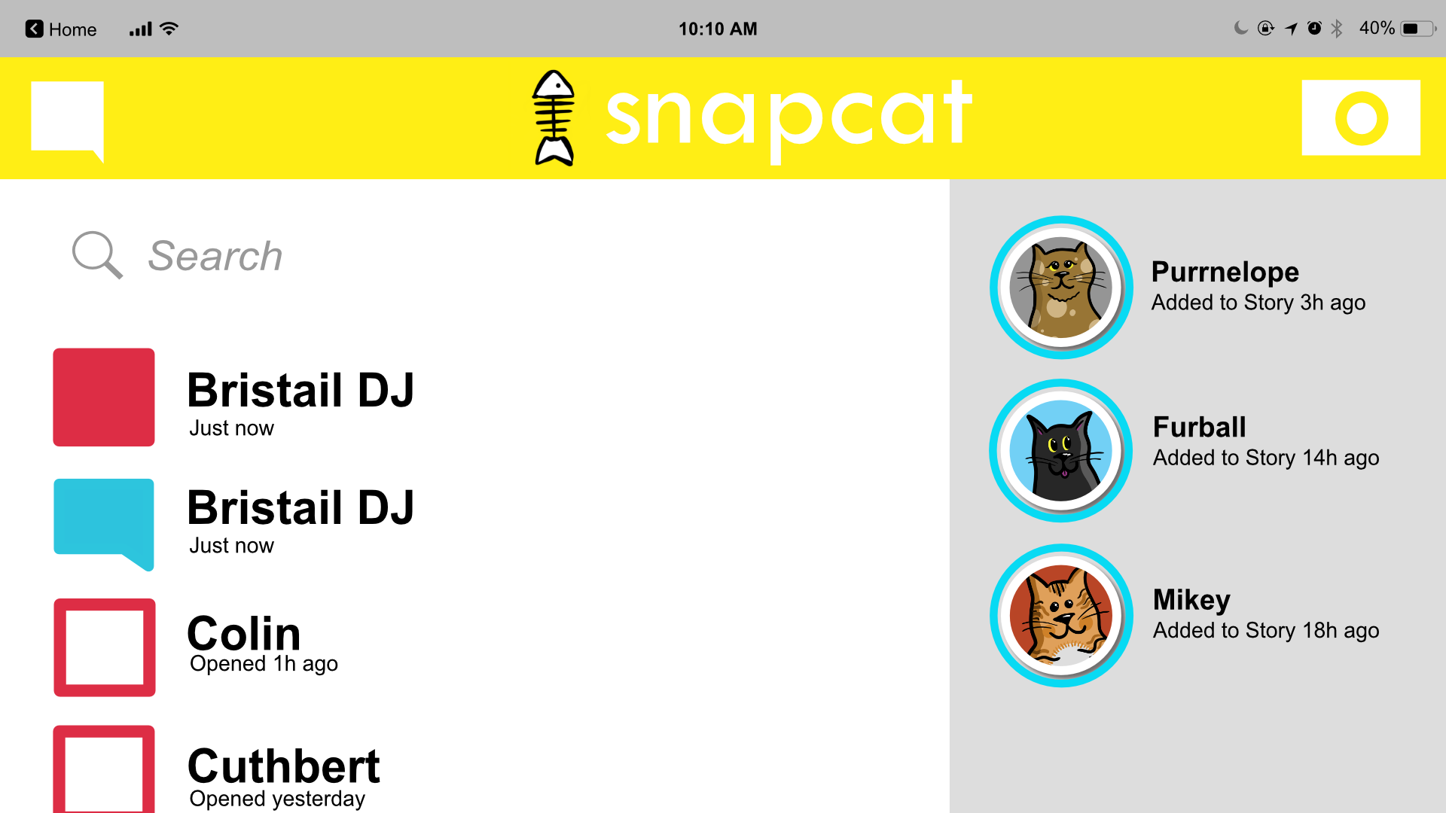

Slide 34
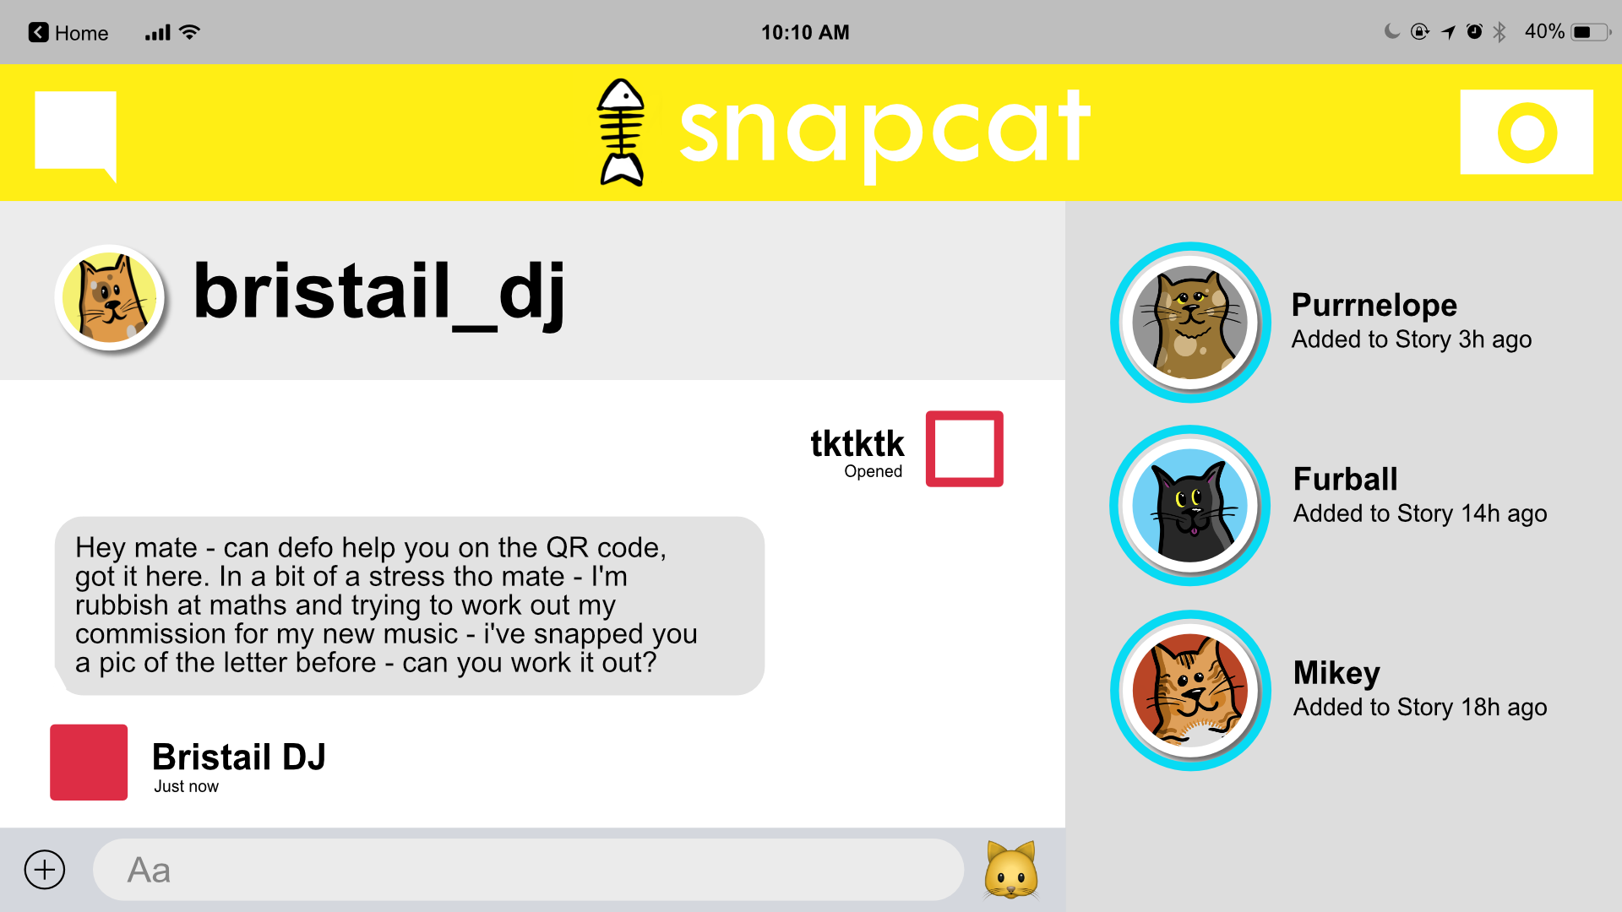

Slide 36
Click here to head over to Spawtify and we'll try and work it out together...

Slide 37
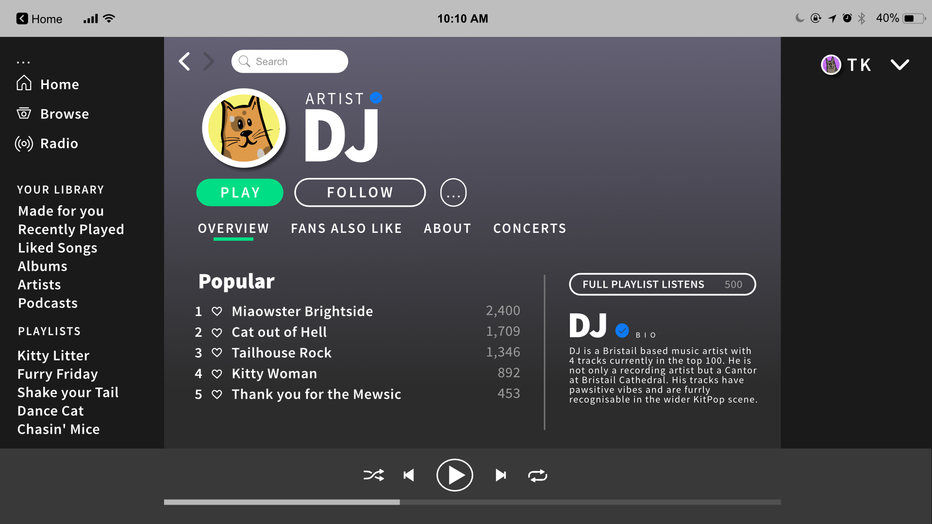

Slide 38
Click back to head to the instructions DJ sent us to work this out. When you have your answer, click on me and I will send it to DJ!

Slide 39
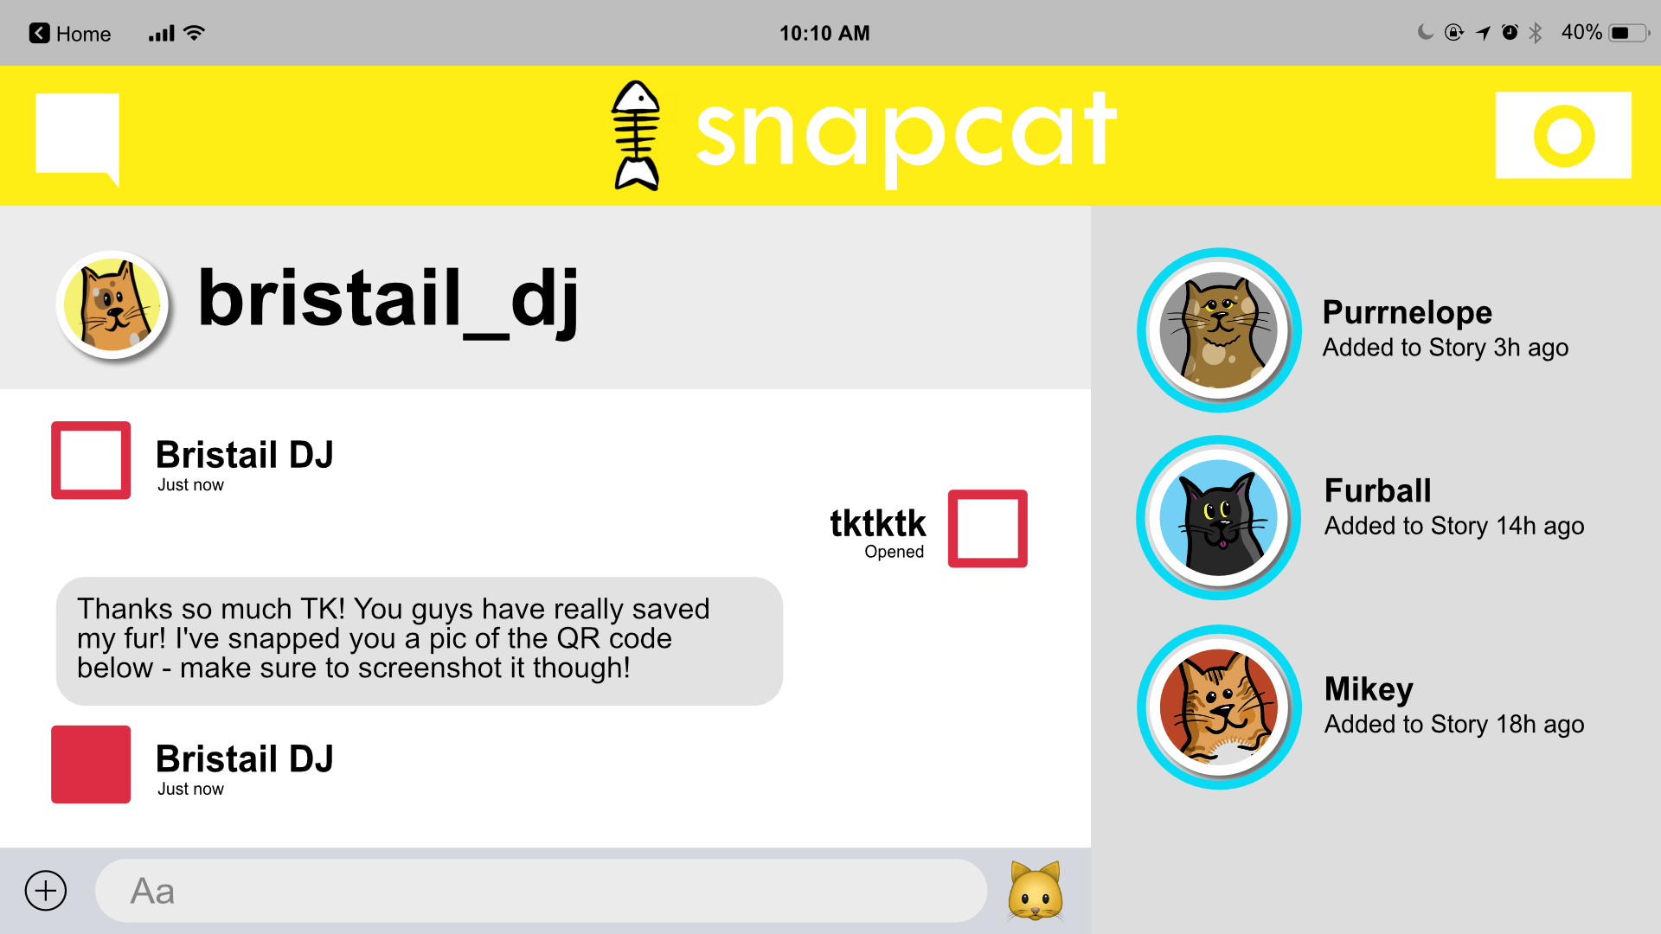
Great work! Click on me to go back to the home page.

Slide 41
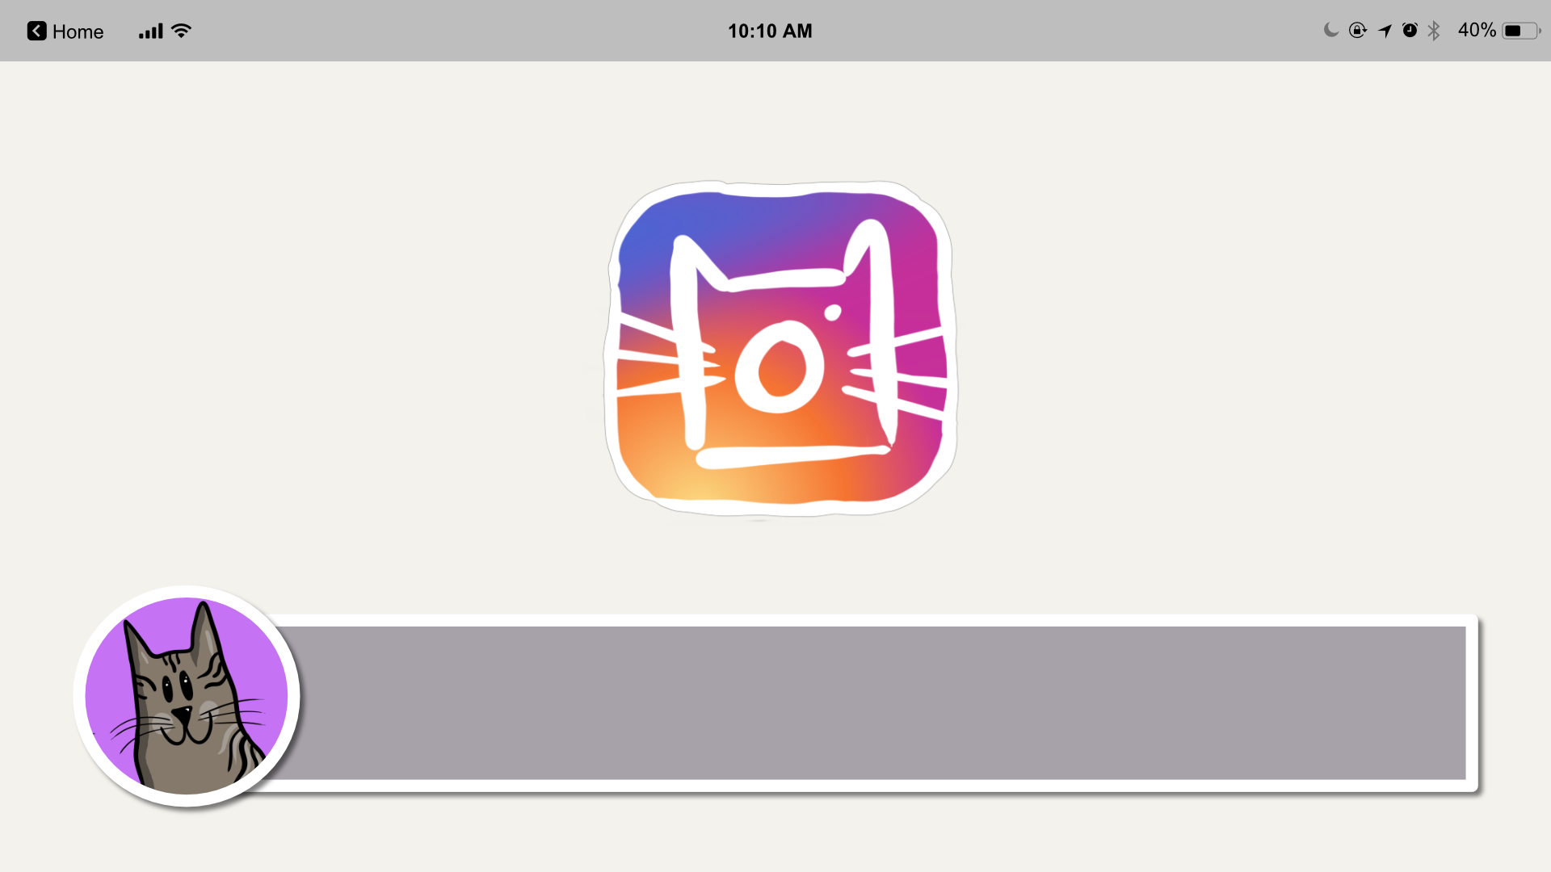
C@Princess works for Manxchester Cathedral doing their social media, let's see what she can tell us.

Slide 42
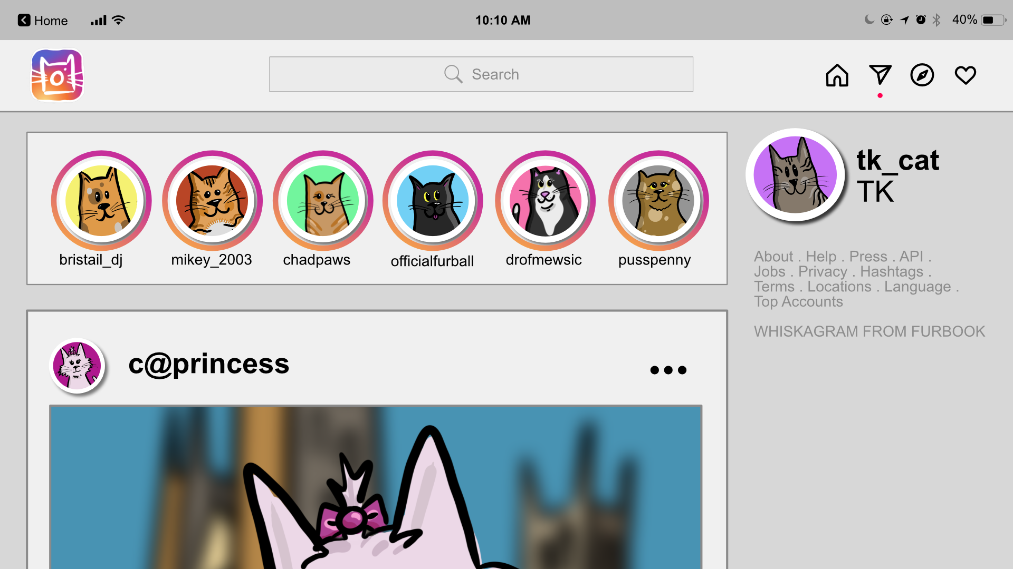

Slide 43
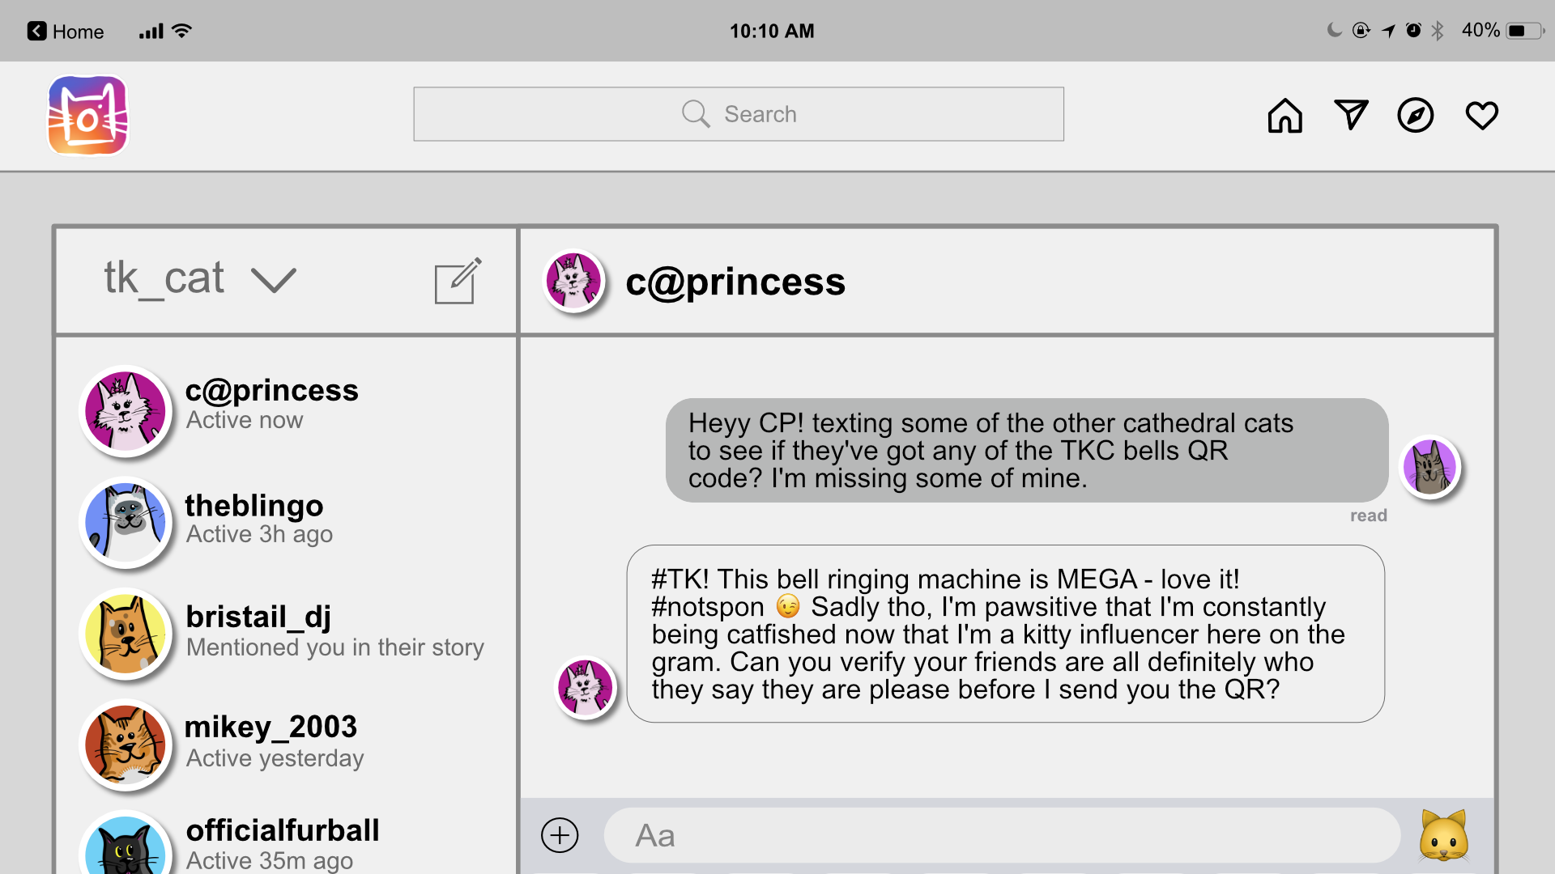

Slide 44
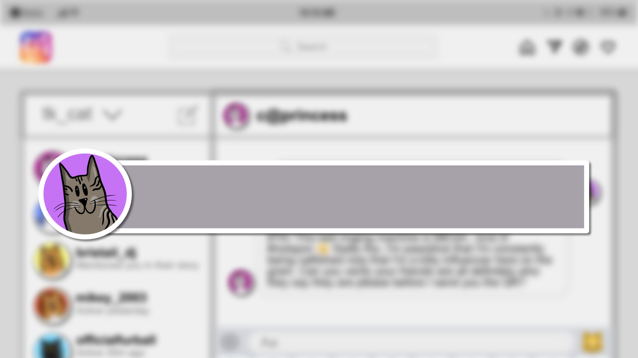
Time to verify your identity! Without lifting your pen from a piece of paper – draw a self-portrait with your eyes closed.

Slide 45
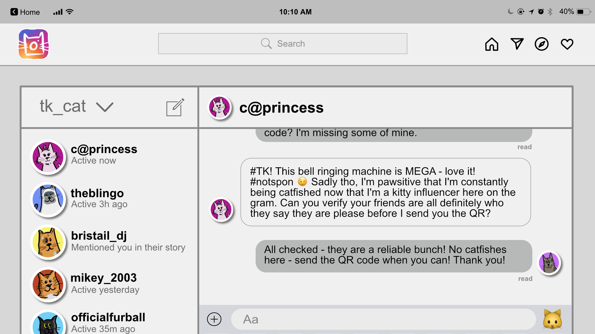

Slide 46
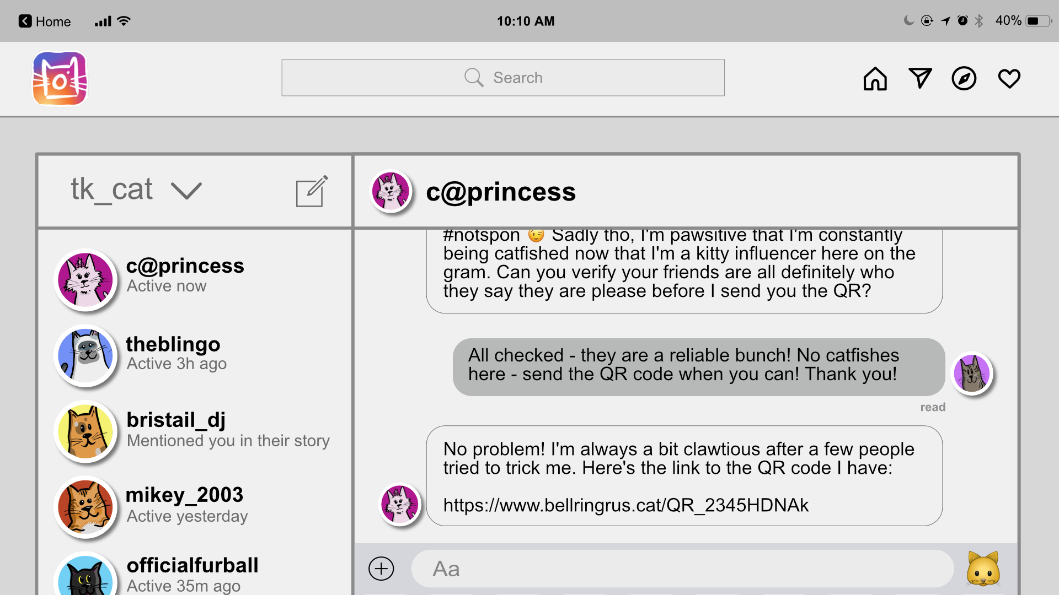
Great work! Click on me to go back to the home page.

Slide 48
Let's see if my friend Furball has responded to my message – he is ALWAYS viral on this new app KitKat.

Slide 49
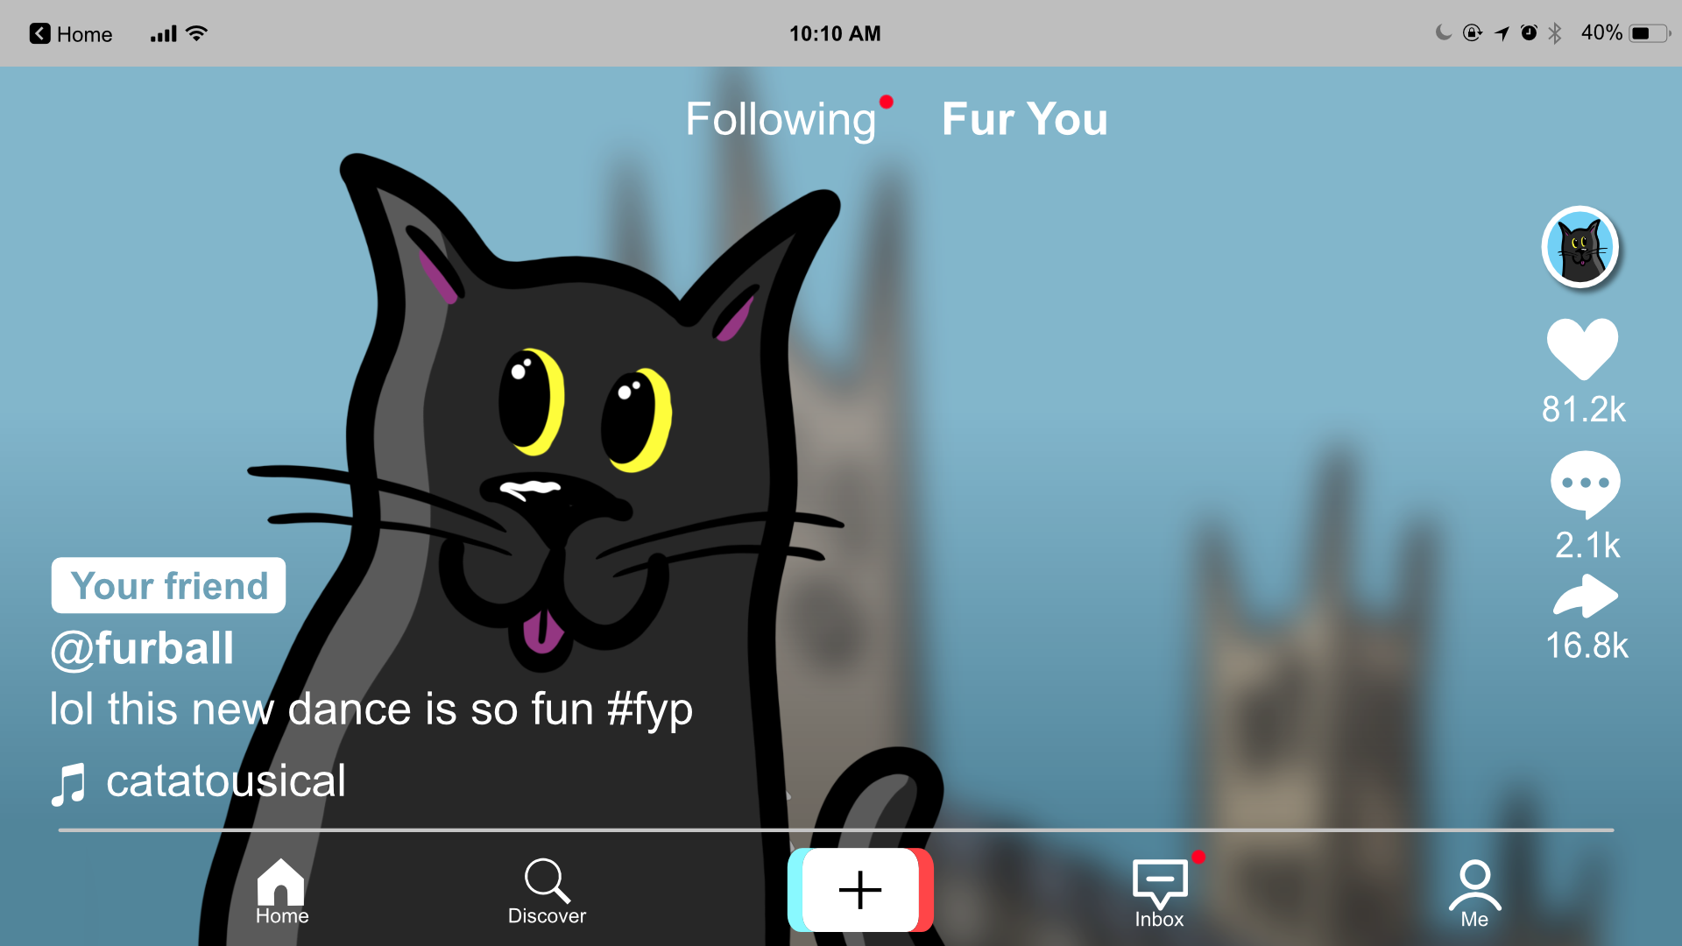

Slide 50
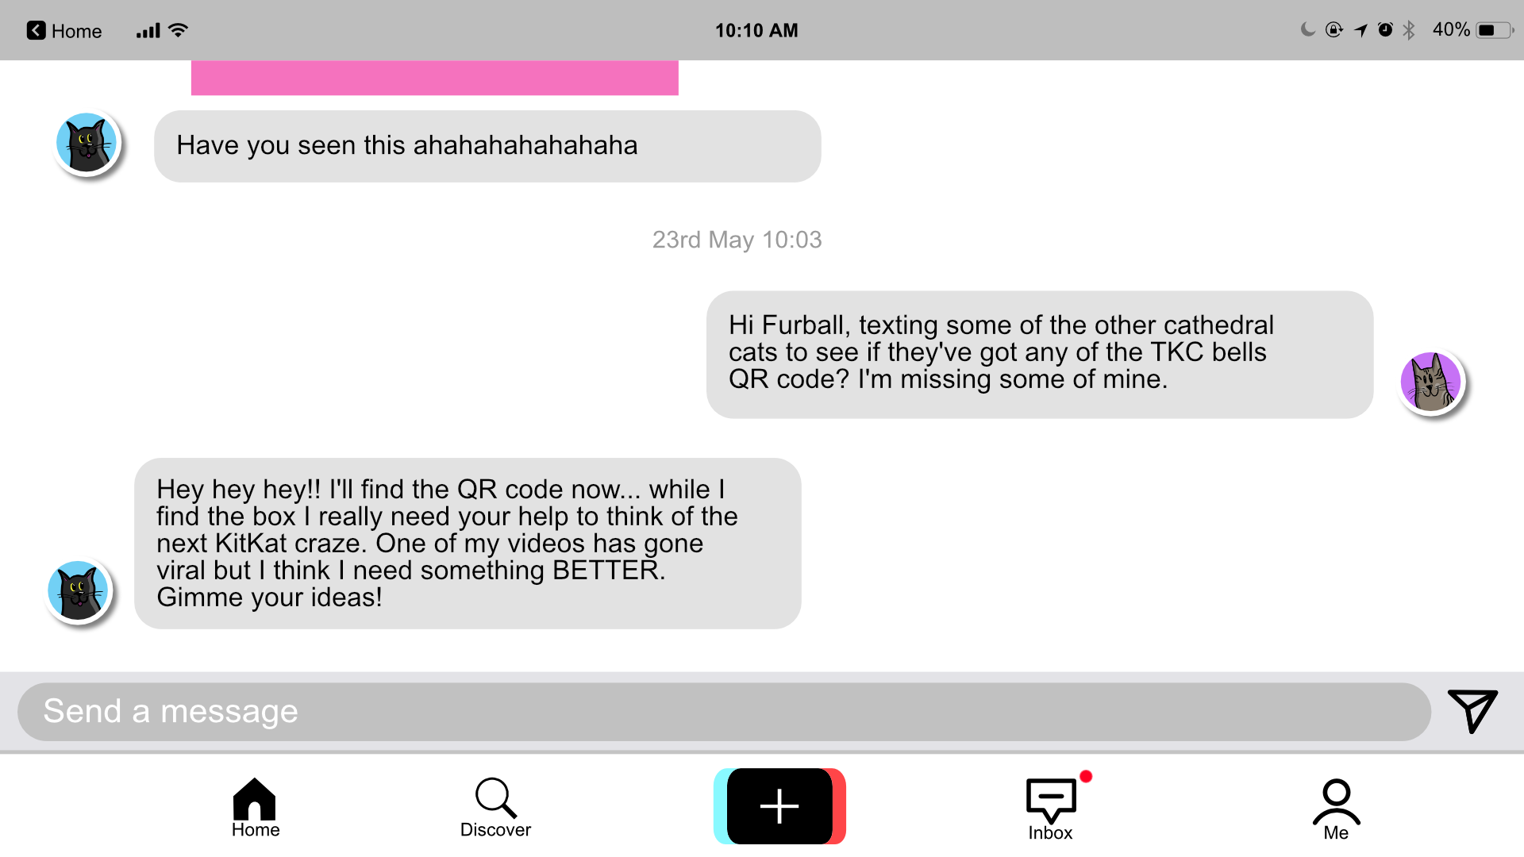

Slide 51
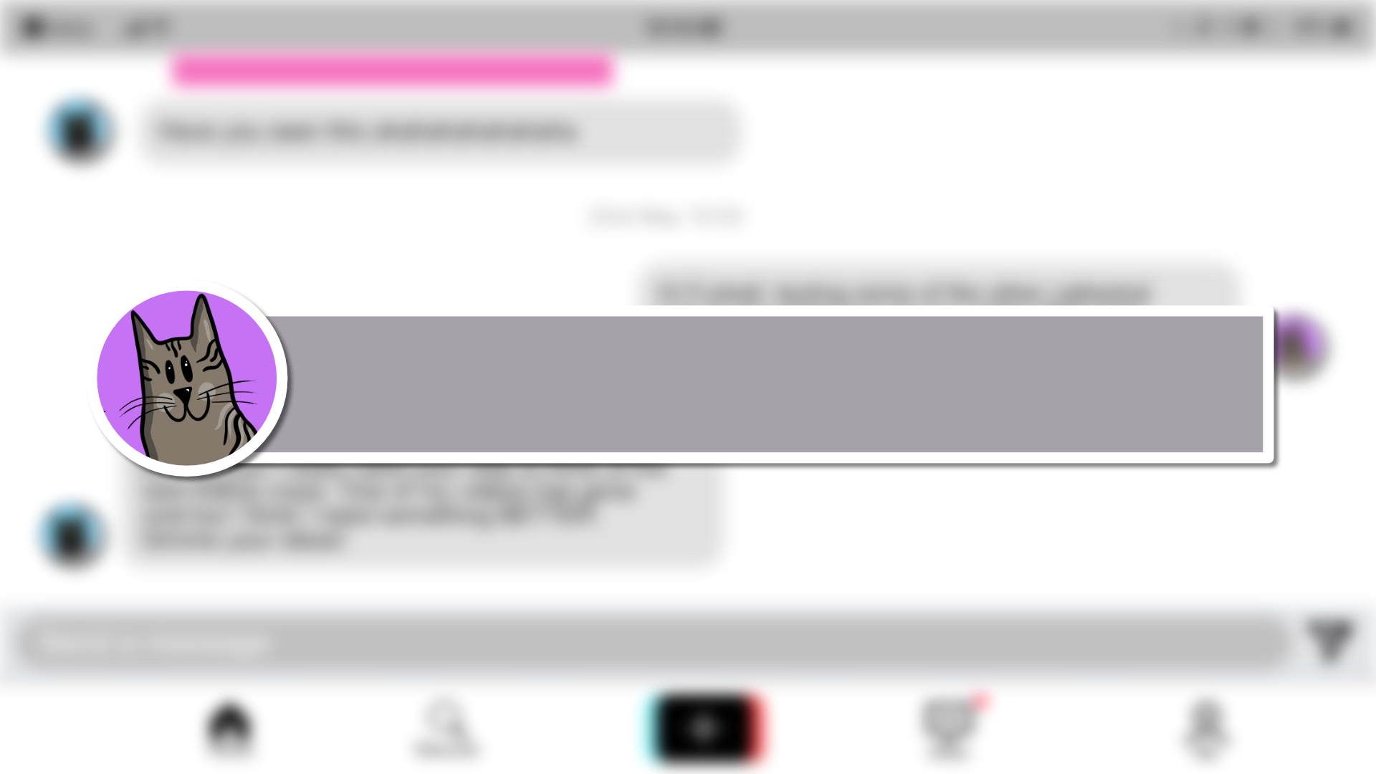
Let's think of something fun! Can you create a dance, a sea shanty, or a joke to help Furball go viral?

Slide 52
Ready? Let's send it off to Furball and see what he thinks!

Slide 53
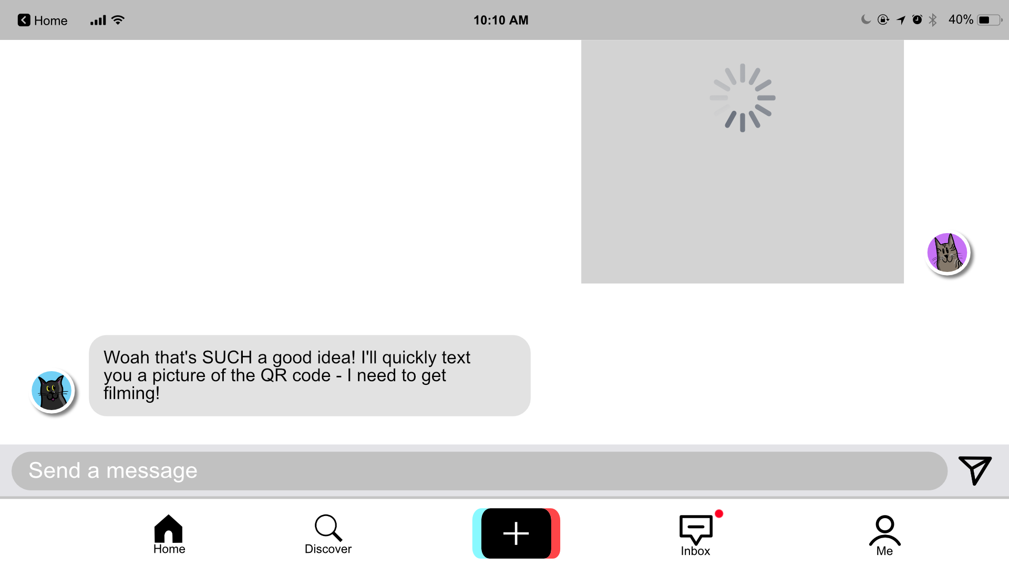
Great work! Click on me to go back to the home page.

Slide 55
Ooh! Let's see if my friend Blingo has replied on Messenger. She lives in Miaowlan in Italy and works at the Duomo di Miaowlano.

Slide 56
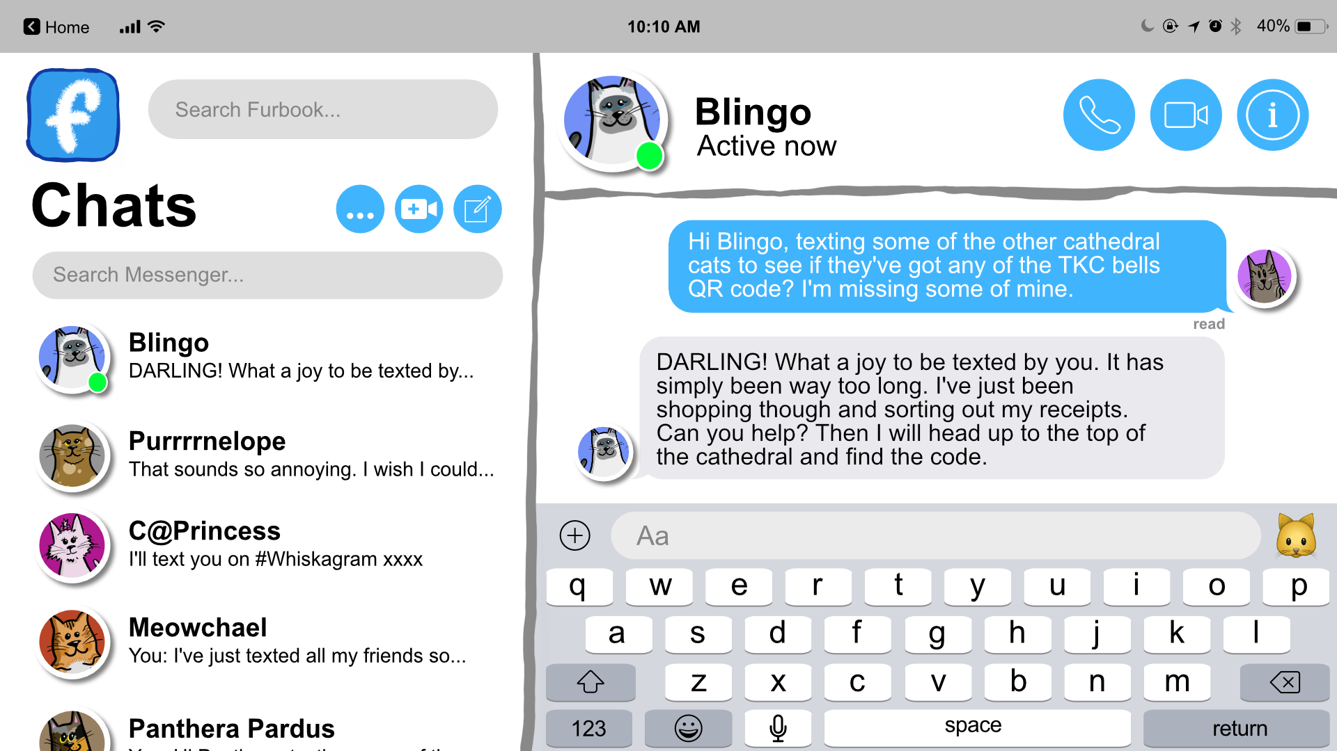

Slide 57
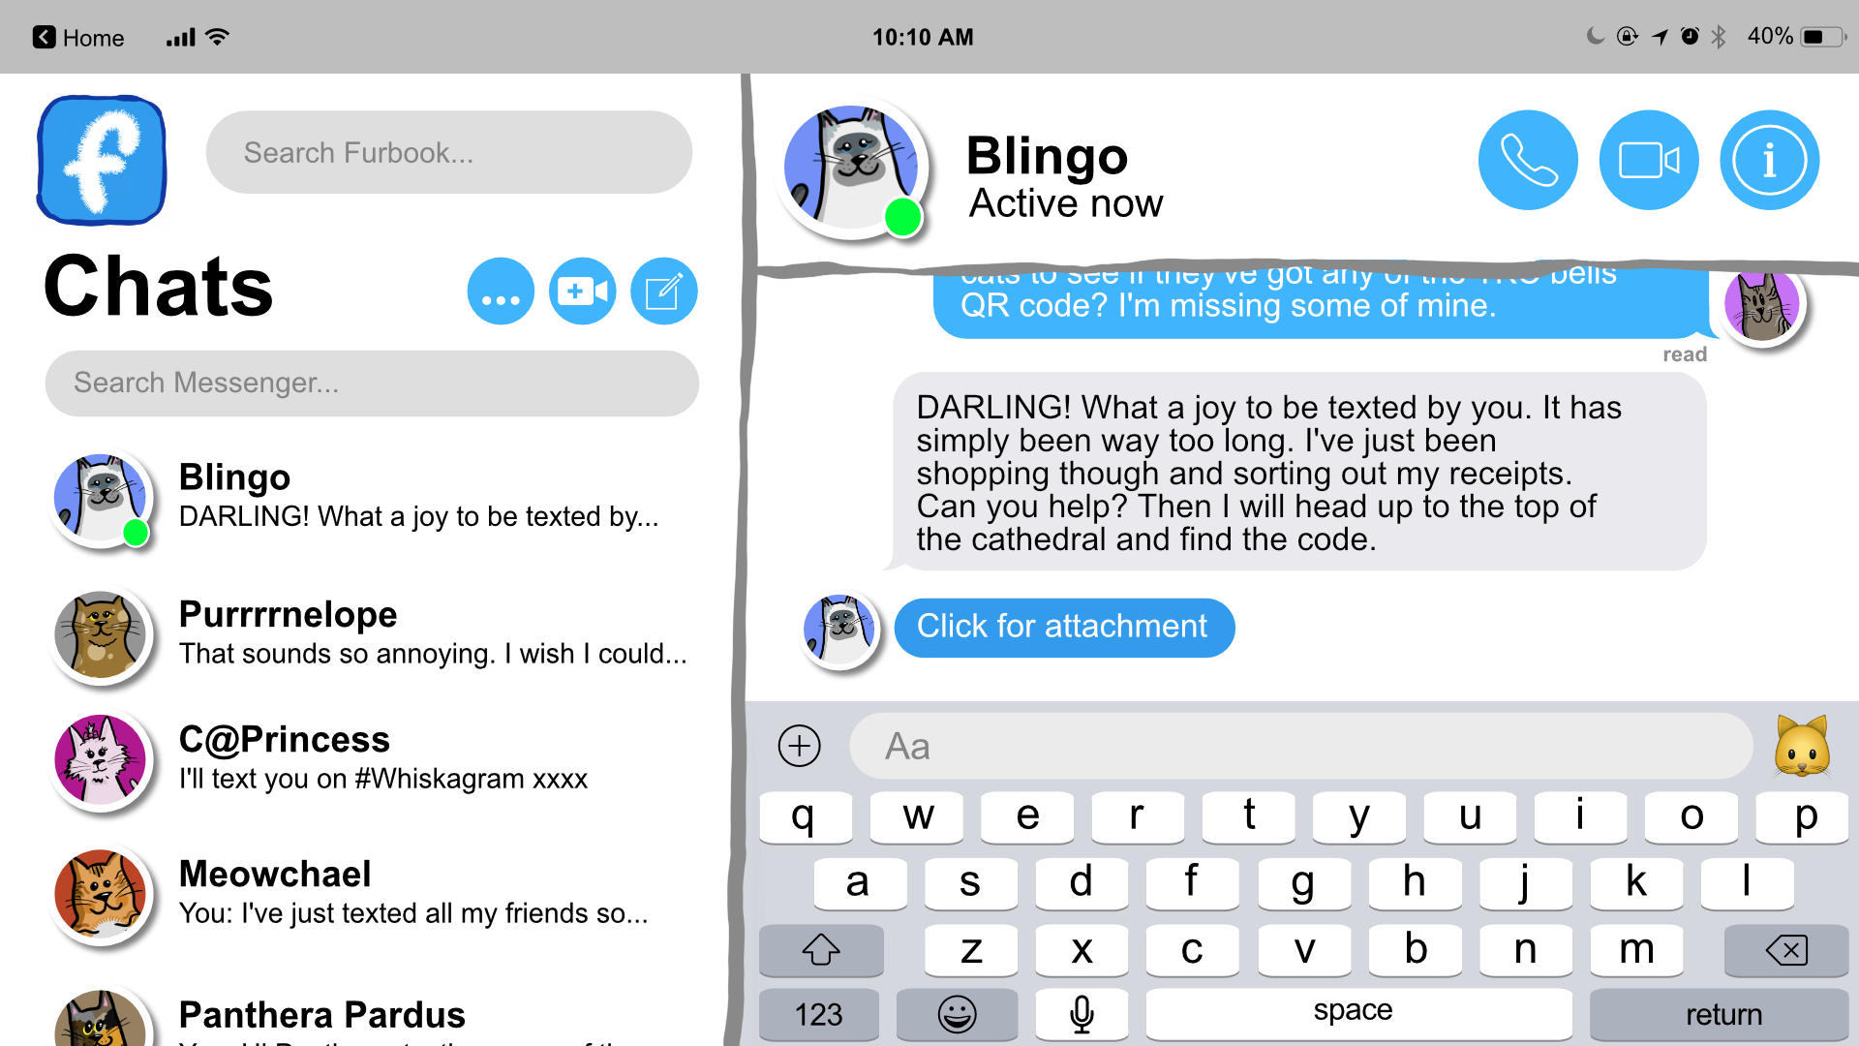

Slide 58
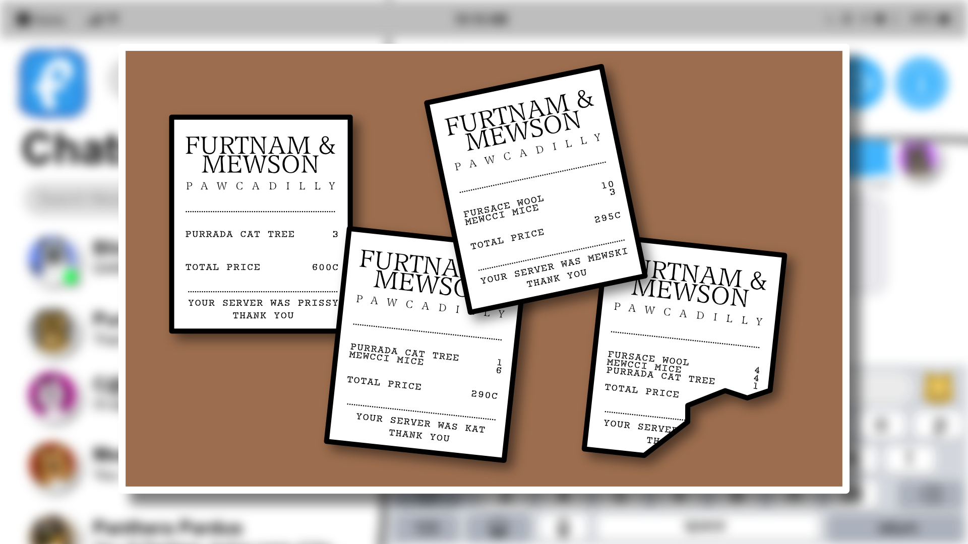
How much did Blingo spend overall?

Slide 59
Got the answer? Click me to tell Blingo.

Slide 60
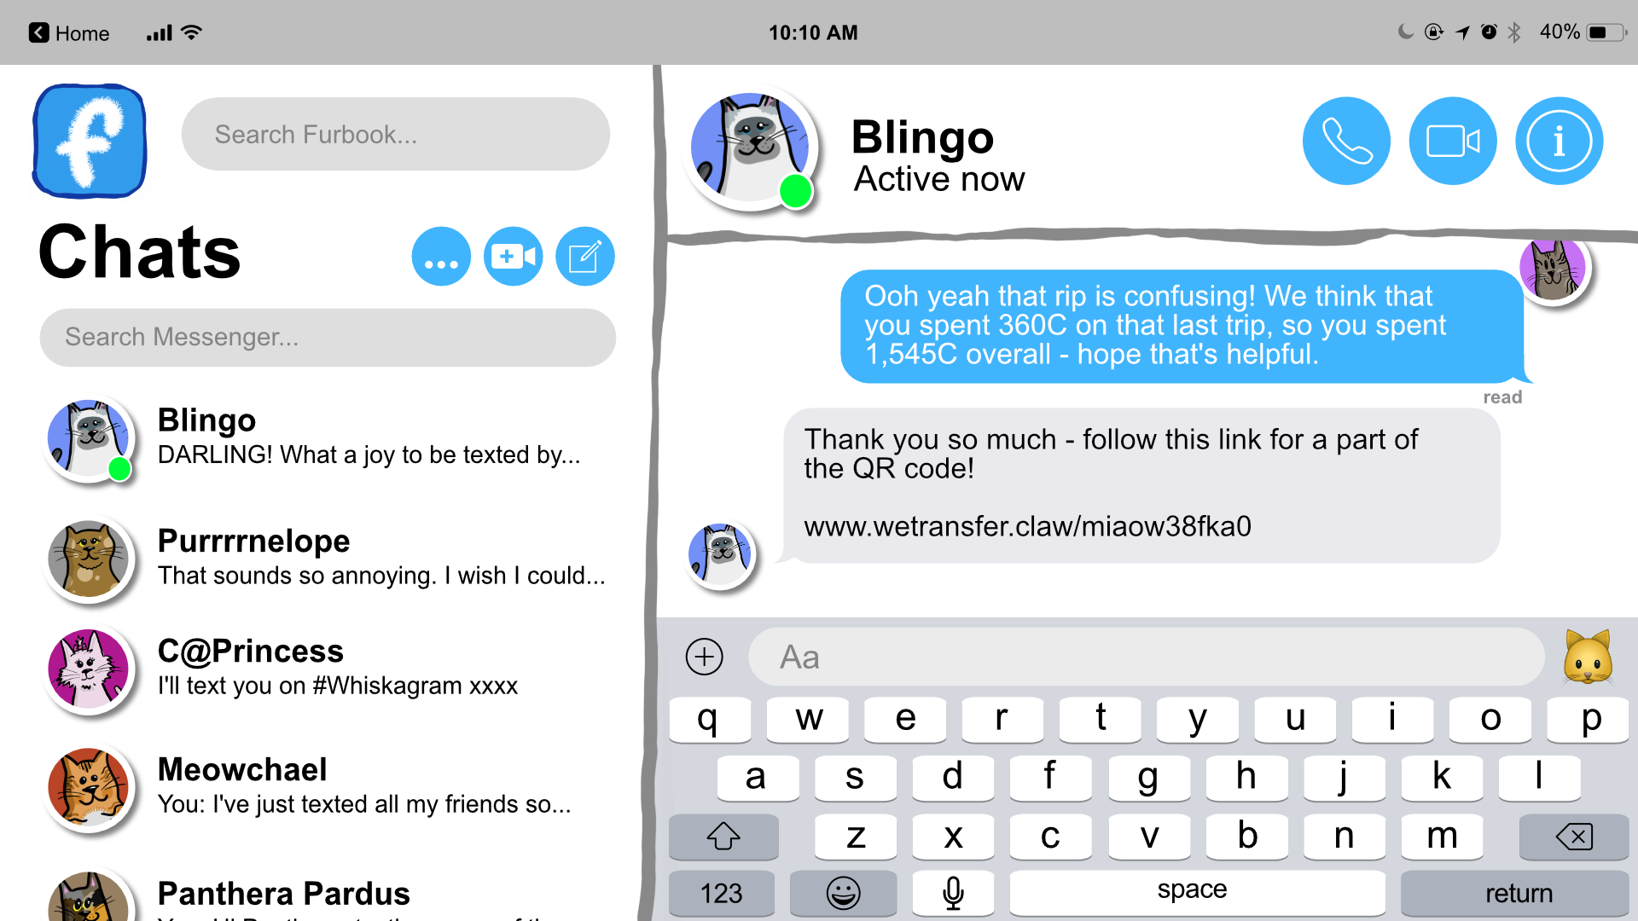
Great work! Click on me to go back to the home page.

Slide 62
Not much to see here, click me to head home.

Slide 64
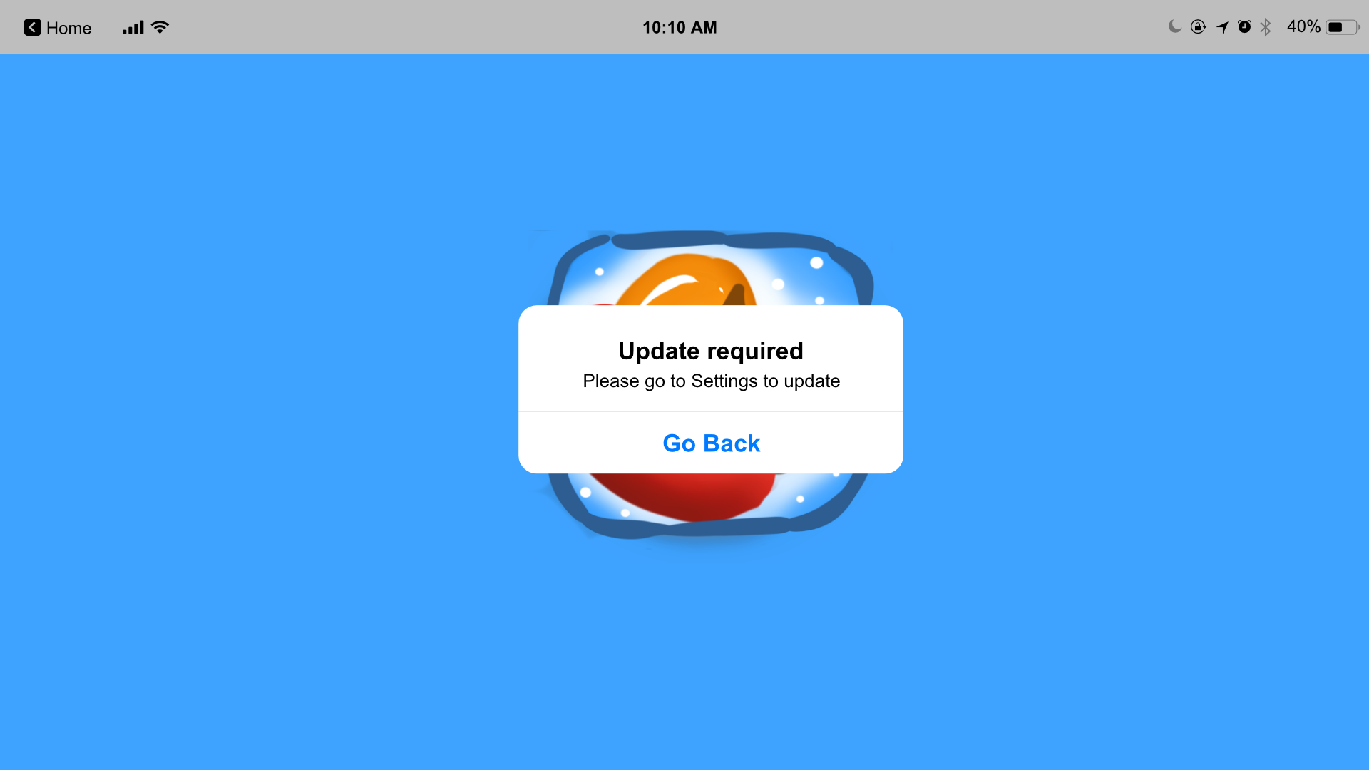

Slide 66
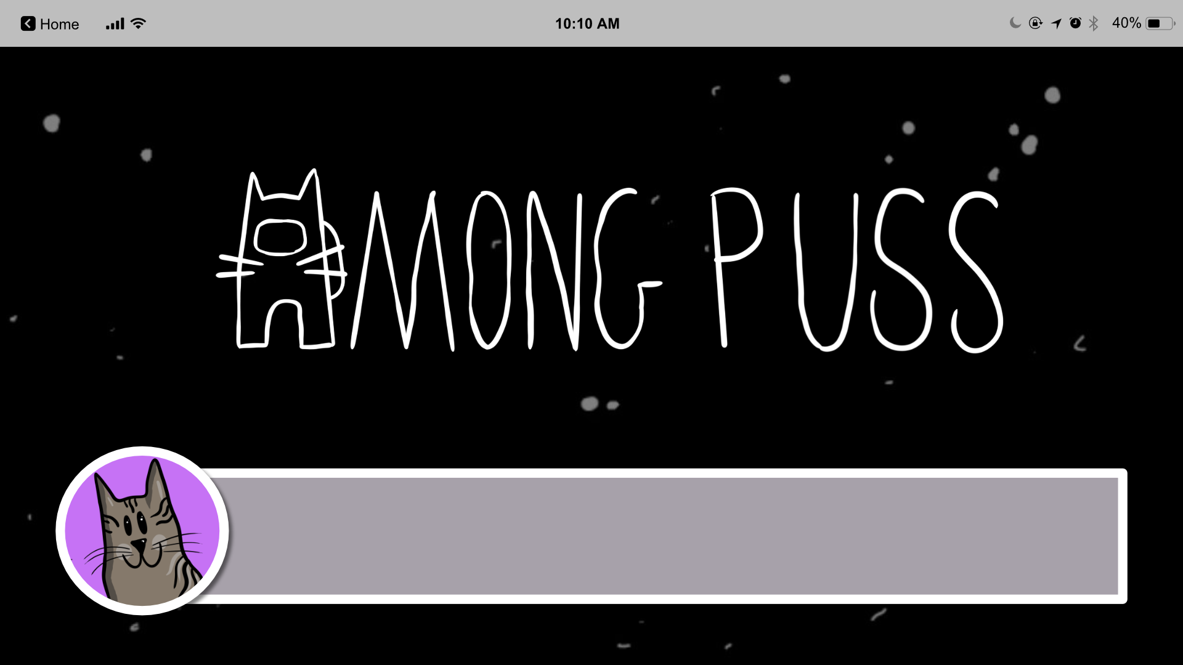
I love this game – though Camo Cat, my friend from South Purrea, is hard to find – if we catch him out he'll send us the QR code.

Slide 67
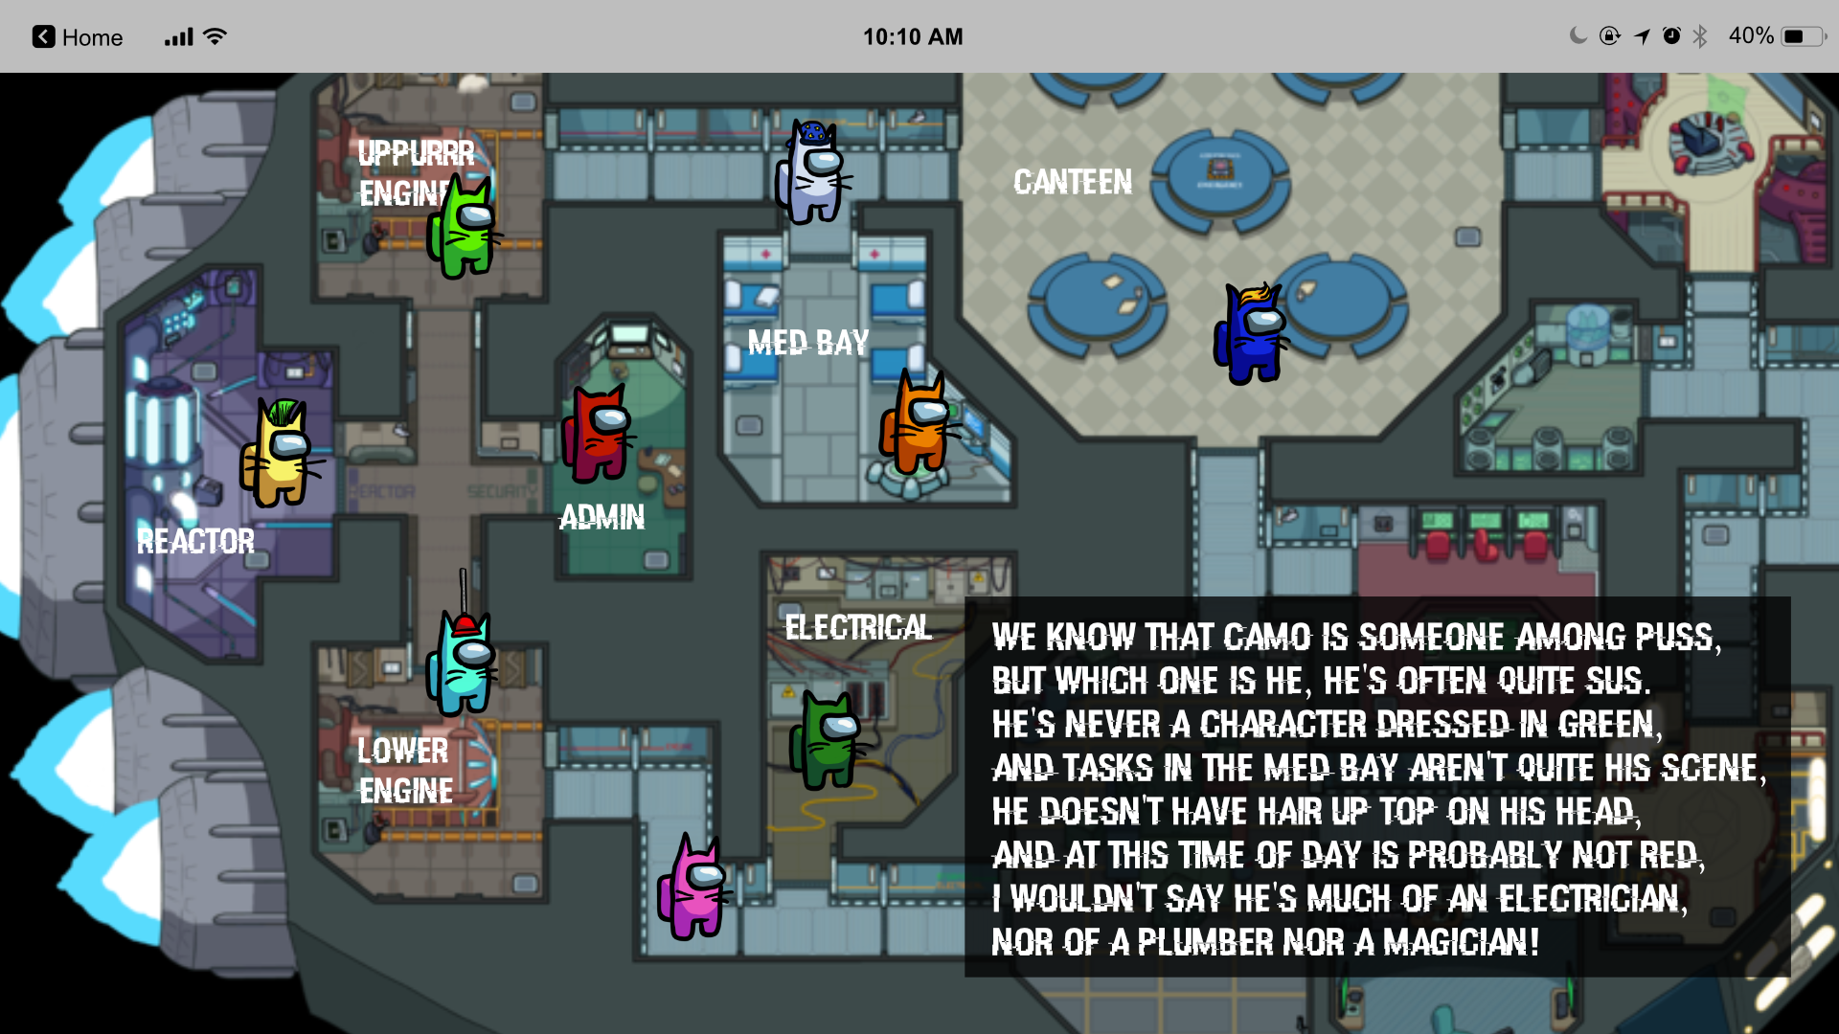

Slide 68
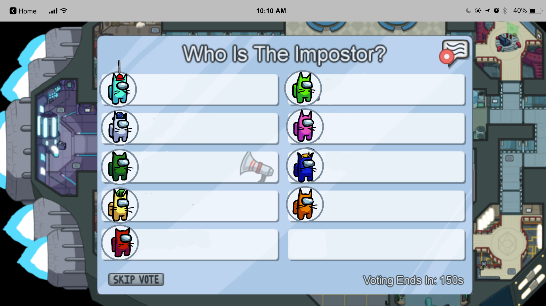

Slide 70
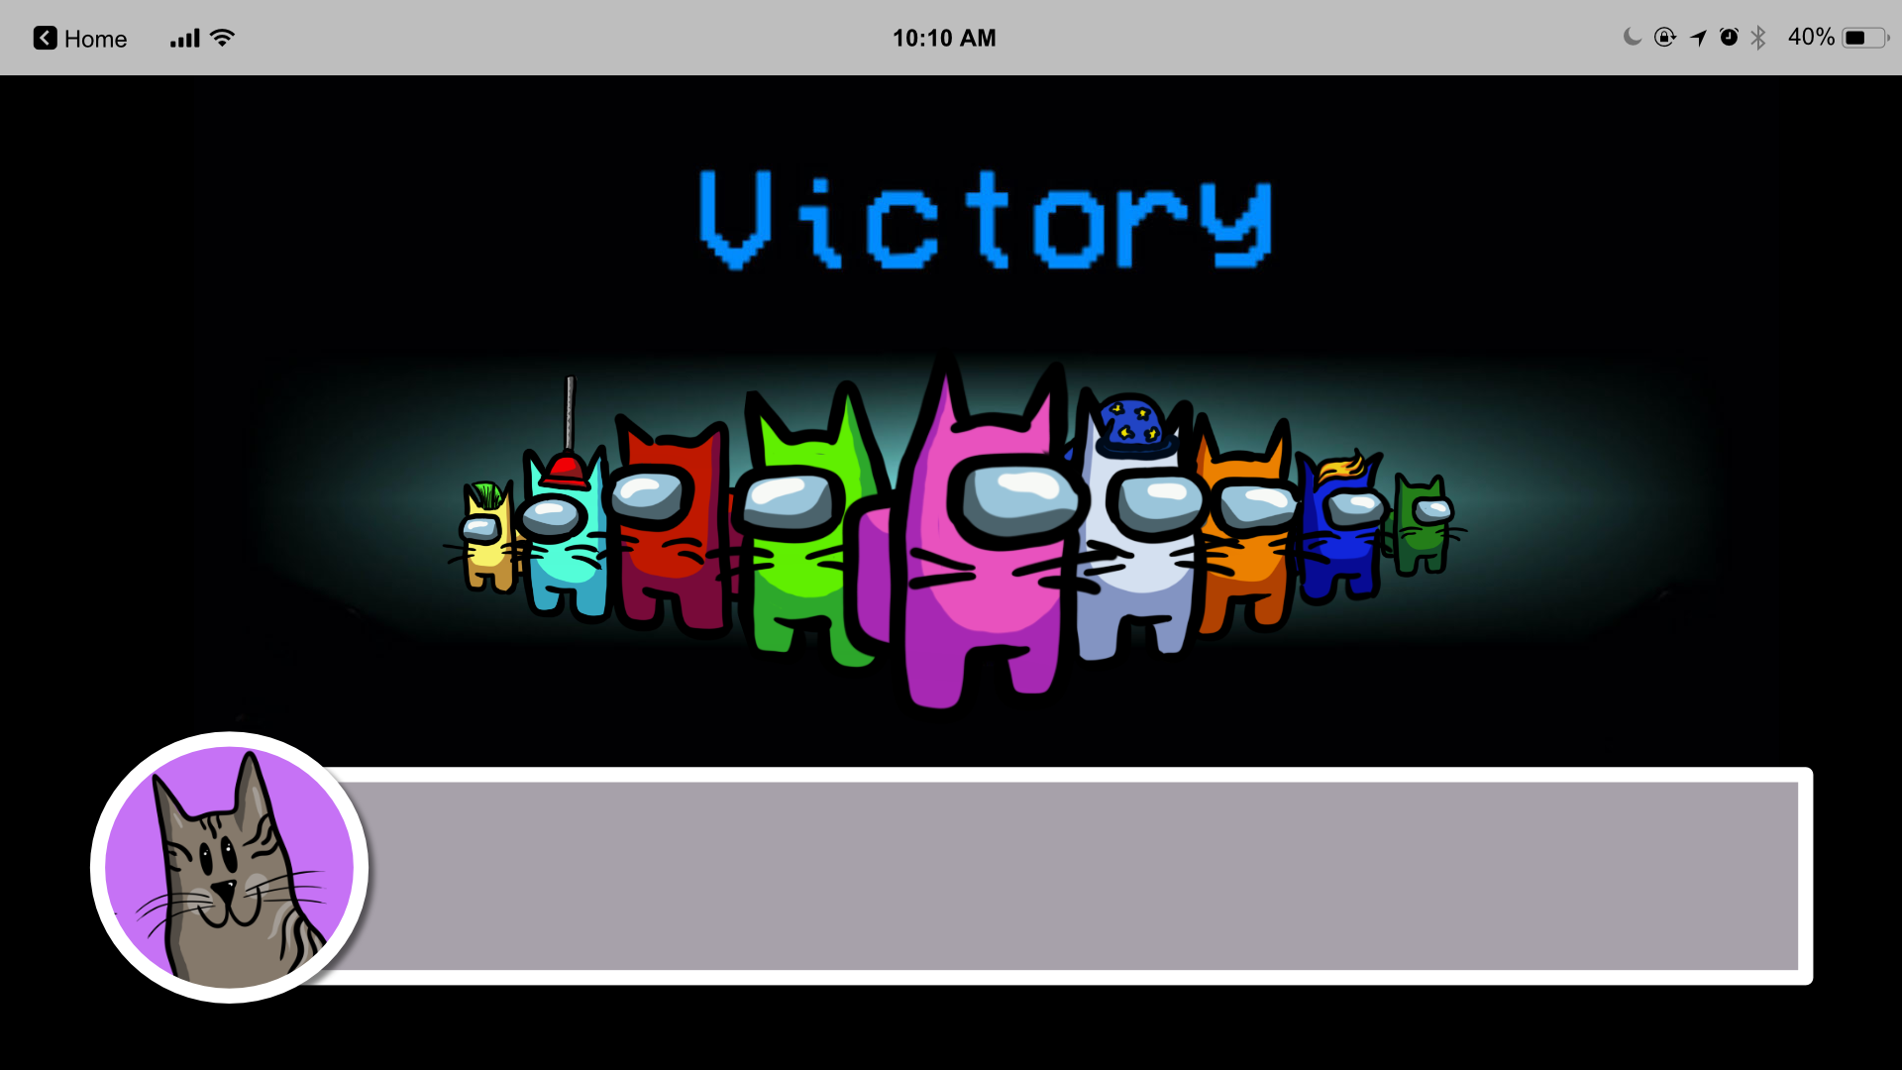
Amazing deduction skills – you found Camo Cat! AND I've just been sent a piece of the QR code from him – what a win! Let's go back to the home page – Click on me to do so!

Slide 72
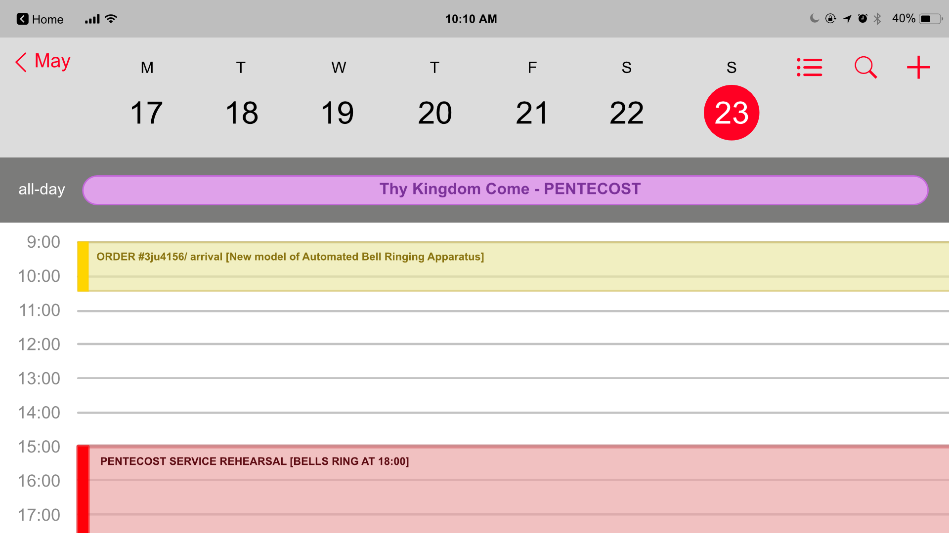
Not long to go until we need the machine to work! Click me to head home.

Slide 74
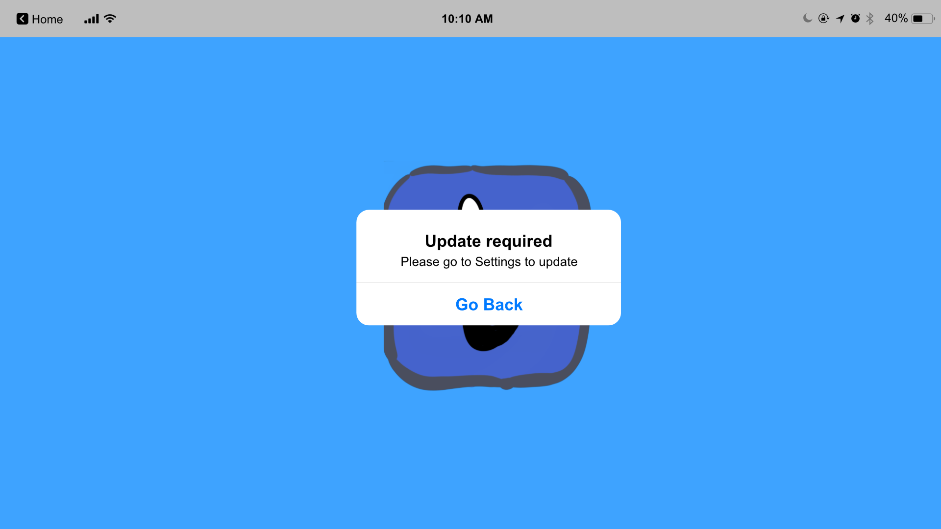

Slide 76
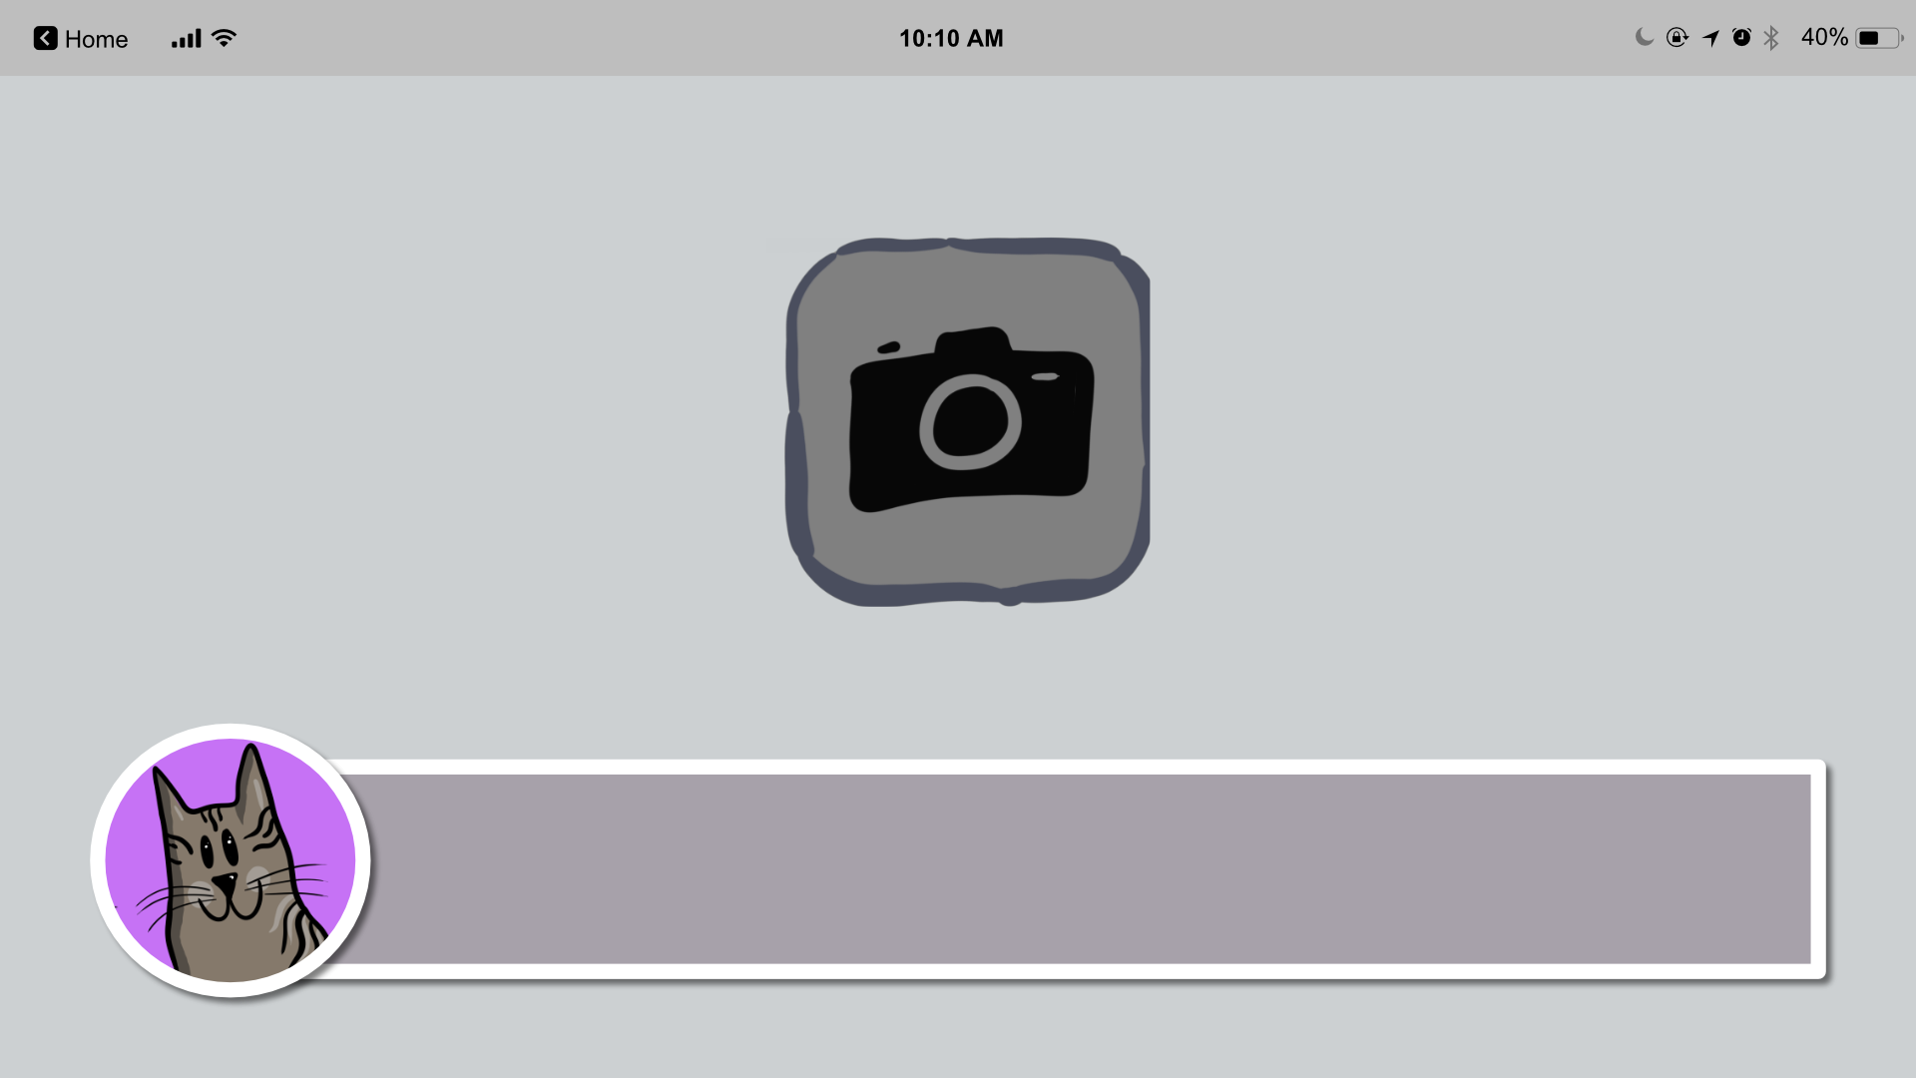
All 8 pieces of the QR code! I can finally build it and scan it... let's see if it all works!

Slide 77
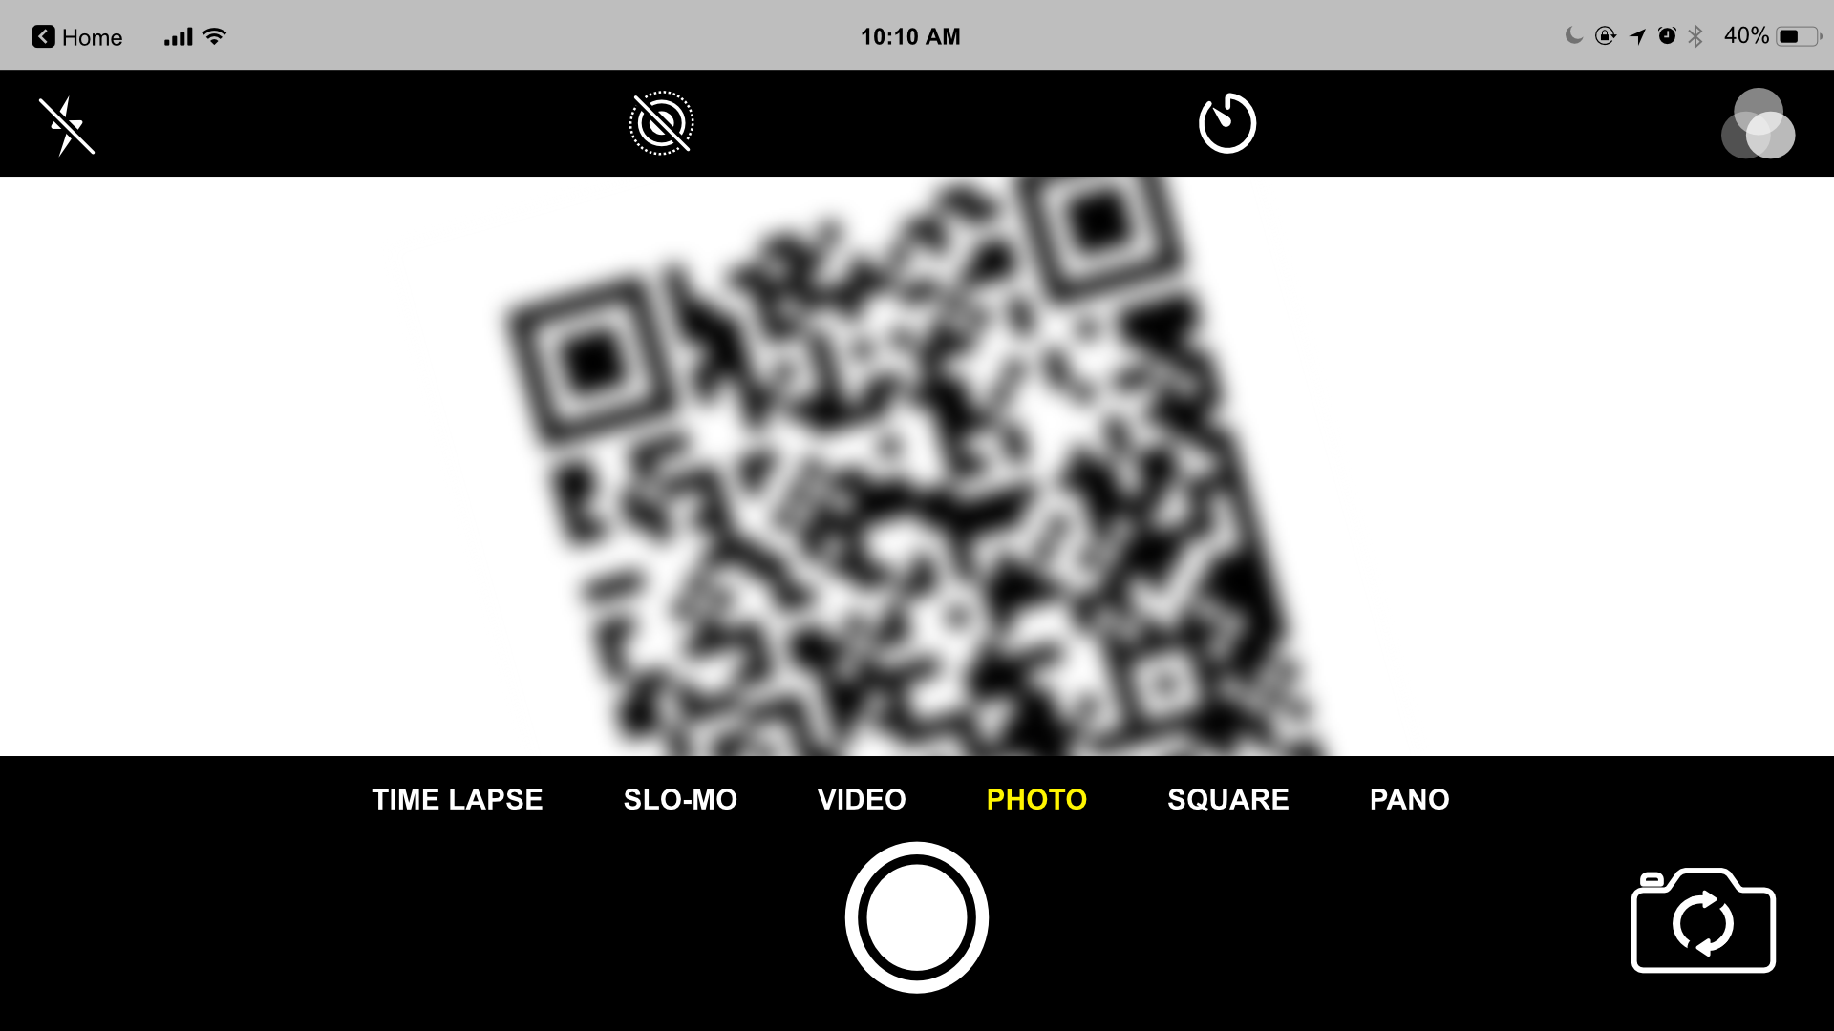

Slide 78
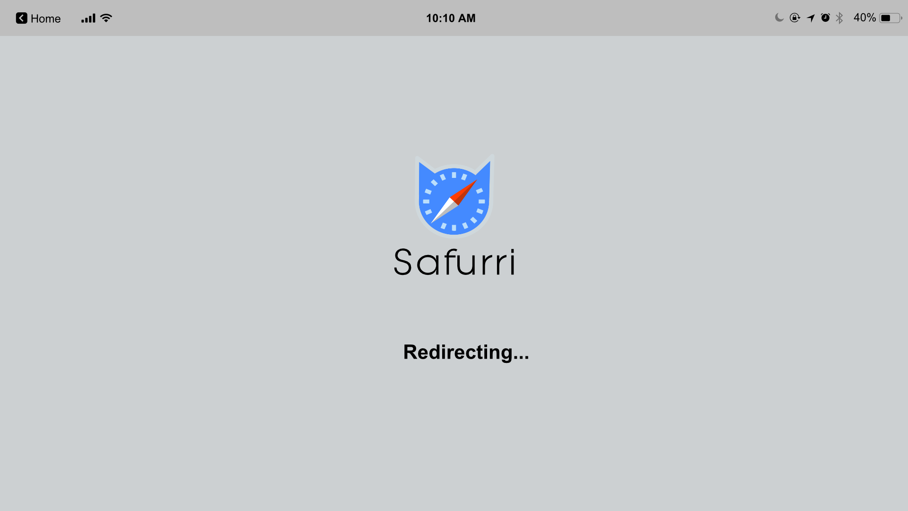

Slide 79
It works perfectly! What a joyful noise. Thank you so much – I hope you enjoy celebrating Pentecost together as a church as much as we will at Catterbury Cathedral.
Maybe we'll see you again sometime...
Created by Jack Percey, Monica Jones, and Dave Thornton (Christ Church, Winchester)

